Slide 1

Defense Travel System
Constructed Travel Worksheet
MCB Quantico LDTA, Tier II Help Desk

Slide 2
Constructed Travel
Prior to performing official travel, the Authorizing Official (AO) will authorize/direct the traveler to use a specific transportation mode (i.e., the directed transportation mode) JTR 0202
Travelers may choose to use a different transportation mode (i.e., the selected transportation mode) JTR Table 2-11
The most common example: AO directs a traveler to use commercial air, but the traveler decides to drive their own car instead. Also known as: Privately Owned Vehicle (POV)
Notes:
Let’s talk about Constructed Travel. This is an extremely important subject for you to grasp regardless of your role because there can really be some problems and pain caused by not following the process properly.
The order of preference changed on March 1, 2024, which directly affected Constructed Travel. This is highlighted in the Developmental Class presented on March 19, 2024 and is available from the Quantico DTS Help Desk website.
Prior to anyone travelling, the AO will authorize a mode of transportation, generally that will be commercial air but could be different depending on the location.
Sometimes a traveler will prefer to use a different mode such as POV and the AO must determine the limit of reimbursement.
With the JTR 0202 change effective March 2024 the CTW process has changed dramatically and will require additional effort to complete this task.

Slide 3
Constructed Travel
The JTR allows the traveler to use their selected transportation mode, but it also directs the AO to limit their transportation reimbursement if their choice is more expensive
This is known as Constructed Travel; lets the AO compare the true costs of the same trip using different transportation modes
Due to JTR 0202 change the Constructed Travel Worksheet (CTW) has also changed, new worksheet dated April 2024 should be utilized, all others are obsolete. https://www.defensetravel.dod.mil/CnstTvl/
Do not use a saved version of the CTW
Notes:
Even though the traveler may select a different mode, The AO has the responsibility to determine what is advantageous to the government and potentially limit the traveler. This is completed through Constructed Travel.
The Constructed Travel Worksheet (CTW) allows the Traveler and AO to see a comparison between the mode the traveler chose (selected mode) vs. the authorized/preferred mode. The CTW changes often so make sure to use the version from the advisory or the pre-audit link. The DTMO website has the most current version there.
March 2024 the CTW was updated, and the new version posted 1 April 2024. All previous versions are not be utilized.

Slide 4
Constructed Travel
JTR 020203.B
  Determination Factors. The AO will consider cost and the following factors when determining mode of transportation most advantageous to the Government for TDY travel.
Notes:
Straight from the regulations.

Slide 5
Constructed Travel
JTR 020210.F
Cost Comparisons Between Use of a POV and Other Modes of Transportation (Computation and Calculation Rules). When a traveler uses a POV instead of an authorized type of transportation deemed most advantageous to the Government, a cost comparison is done to determine reimbursement. The POV mileage is compared to the constructed cost of the authorized transportation type and the lesser of the two amounts is reimbursed. The constructed cost is the sum of the transportation ticket cost, the TMC fee, and other related costs that include, but not limited to, taxi and TNC fares, terminal mileage, baggage fees, ferry fees, parking, or rental car when authorized and necessary. The per diem that the Government would have incurred if travel had been performed by the authorized transportation mode is paid.
Notes:
Straight from the regulations.

Slide 6
Constructed Travel
The conditions for a Constructed Travel Worksheet (CTW) have now changed
  A CTW is not required if you will use the transportation mode that the AO authorizes or directs for every leg of your travel.
  A CTW is not required if government transportation is authorized or directed.
  A CTW is required any time you use your Privately Owned Vehicle (POV).
    A POV can be a privately owned automobile, motorcycle, airplane, or boat.
Keep in mind that a CTW is not required for local travel or when using your POV to travel to/from the terminal.
Notes:
CTW is not required when using the standard mode, when government transportation is utilized or for local travel.
CTW is required whenever a POV is utilized.

Slide 7
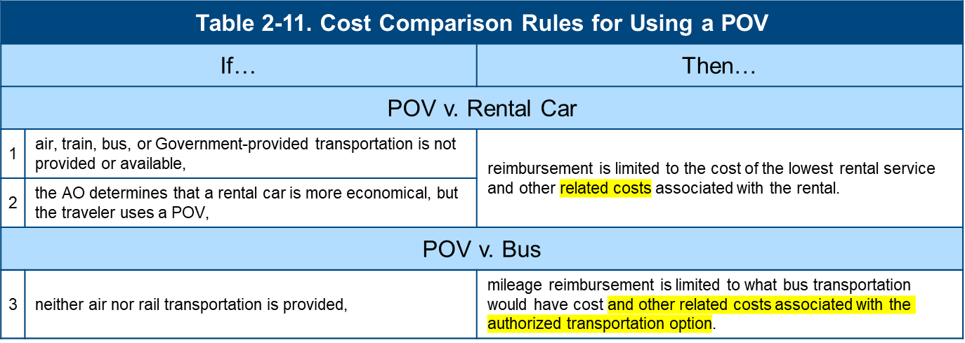
JTR Table 2-11-POV
Notes:
These next few slides lay out the ground rules on reimbursement between differing modes of transportation.

Slide 8
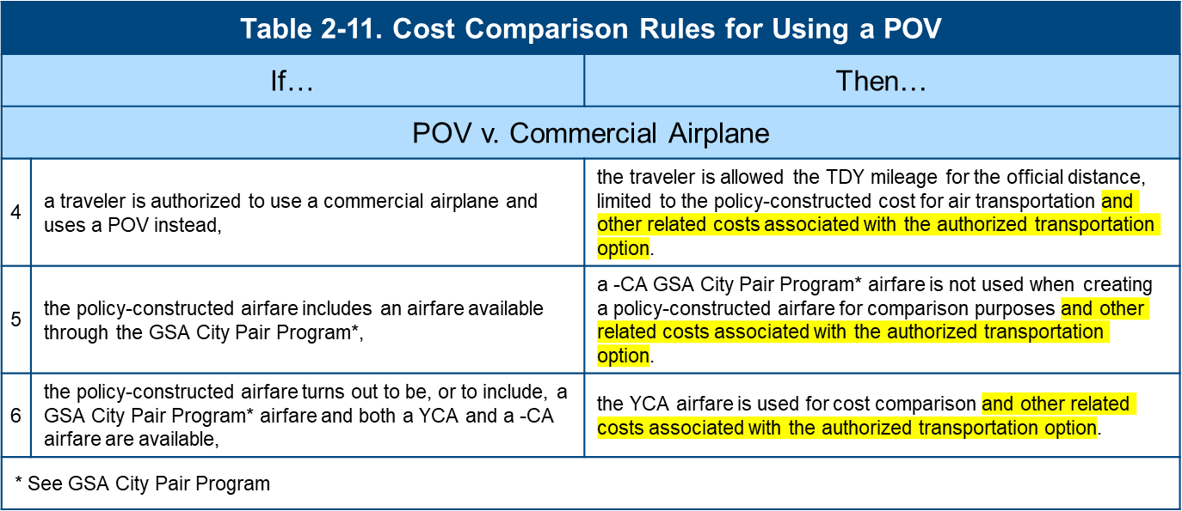

JTR Table 2-11-Air
Notes:
Note 4 is a specific change that now allows for the comparison of the true cost vice transportation only limitation that was in place prior to 1 March 2024.
Note 5 states limited capacity airfare (-CA) is not to be used in this comparison.
Note 6 explains YCA rate is used for cost comparison. It’s shown as the Gov’t Contracted Rate in DTS

Slide 9
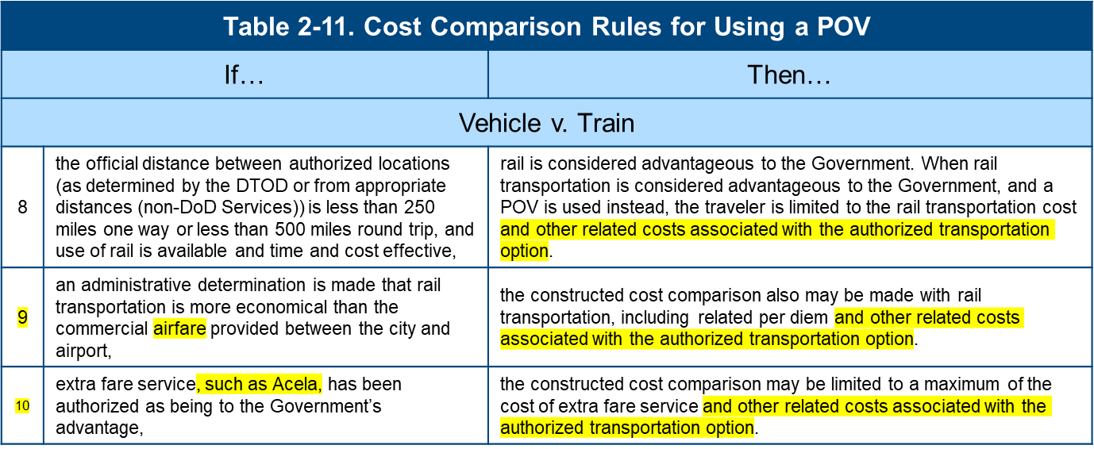
JTR Table 2-11-Rail
Notes:
Additional considerations for rail service. For those assigned to MCB Quantico, the existence of the AMTRAK station in Q-Town and Union Station in DC, will require consideration for the use of rail to points south of Quantico and into the Northeast parts of the country.

Slide 10
Summary of Changes
The most preferable mode of travel has now changed.
  > 250 Miles – Air
  <= 250 Miles – Rail
    If Rail is not Available, or when travel must be by automobile, the order of preference is:
      Government Vehicle
      Rental Vehicle
      POV only after the other transportation types have been considered
A CTW is required when the traveler intends to drive their POV (even ZEV)
The “Related Costs” associated with each type of directed travel is now factored into the Constructed Travel Cost.
Notes:
Summary of the changes we just discussed.
Elimination of the 400/800-mile rule, new rule established centered on 250 miles & the encouragement of rail
POV only after all other transportation types have been considered
Related cost are now factored in

Slide 11
Constructed Travel Worksheet
When Constructed Travel applies, here’s what happens:
  The traveler creates their DTS authorization to show the total costs of the trip for their selected transportation mode.
  The traveler completes a Constructed Travel Worksheet (CTW) to show the estimated cost (a.k.a., the constructed cost) of the directed/preferred/standard transportation mode and attaches it to the DTS document. Lines 2A through 2M are required on every CTW.
  The AO considers the information in both the authorization and the CTW and decides how to authorize the trip:
    To allow full reimbursement for the selected transportation mode.
    To allow the traveler to use their selected transportation mode limiting the traveler’s transportation reimbursement to the constructed cost of the directed transportation mode.
Notes:
Here’s how the process works if the traveler is choosing to use a selected mode that is different than the directed/authorized mode.
The traveler creates their DTS authorization to show the total costs of the trip for the selected transportation mode such as POV mileage To/From TDY.
The traveler then completes a Constructed Travel Worksheet (CTW) to show the estimated cost (a.k.a., the constructed cost) of the directed transportation mode and attach it to the DTS document. The traveler can also include cost avoidances and additional considerations on the CTW
The AO will then consider the information in both the authorization and the CTW and decide how to authorize the trip. The AO has two options, they are:
To allow full reimbursement for the selected transportation mode
To allow the traveler to use the selected transportation mode, but limit the transportation reimbursement to the constructed cost of the directed transportation mode
Remember, the AO must have the government’s best interests at the center of this decision, they cannot “hook a friend up”. Their job is to get the mission accomplished as efficiently as possible, the traveler’s convenience or desires can not factor into that decision.

Slide 12
Constructed Travel Worksheet
  Scenario:
  EXAMPLE ONLY - May not reflect current $ values for air, rental, etc.
  Traveler is directed to Tampa, FL (33608) for 7-day TAD period (1 travel day down, 5 duty days, 1 day travel return)
  Traveler resides in Stafford, VA (22556)
  Traveler is directed to use standard (preferred) mode (Air) but requests to drive a POV
  No additional travelers are making the trip
Notes:
Let’s walk through a scenario together that illustrates the process. Every CTW situation is different and must be handled on it’s own merit, this is just an example.
A traveler is directed to MarCent, Tampa, FL for a 5-day TAD period, that’s 5 TAD days and a travel day each way totaling 7 days.
The traveler lives in Stafford, specifically in the 22556 zip code. The zip code is important because that’s how you claim mileage to/from TDY.
The AO directed the traveler to use the standard mode which is air (this is normal and the whole point of this process)
No other travelers are making the trip. This is an important note that will be used in section 2.

Slide 13
Constructed Travel Worksheet
  How do you determine what the contract airport is?
  MCBO 7220.1D para 4.g directs IAD & DCA as the servicing terminal for MCBQ
  Richmond may be considered when equal to or less than IAD & DCA
  GSA City Pair search contains all contract routes, the cheapest route is considered the servicing terminal City Pair Program (CPP) | GSA
  Traveler will need to gather additional information
Notes:
Contract airport is defined as the terminal that has the lowest cost YCA fare for the route being used. Next slide will demonstrate this more clearly.
When a traveler is requesting to use something other than the standard mode the responsibility is on the traveler to collect and present the information to allow the AO to make an informed decision. The JTR does not allow the AO to make this decision without a clear understanding, JTR 010104. The CTW is designed to assist the traveler and the AO to adhere to JTR 010102 & 010103.

Slide 14

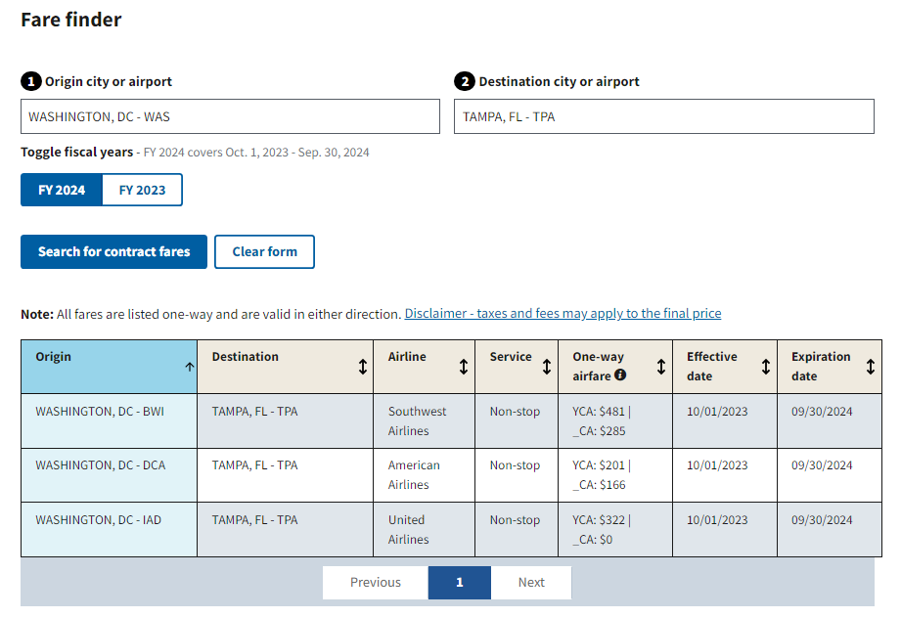

Constructed Travel Worksheet
https://www.gsa.gov/travel/plan-a-trip/transportation-airfare-rates-pov-rates-etc/airfare-rates-city-pair-program
Notes:
Using your favorite search engine type in the words GSA City Pair, the first option should give you the link indicated above by the right facing arrow.
If you are unsure of the which airport is the contract airport you may use WAS in place of BWI, DCA and IAD. RIC is not included in this search. Placing WAS in the origin and Tampa (TPA) in the destination returns the result currently displayed. This query determines that DCA is considered the contract airport as it has the cheapest YCA cost.

Slide 15
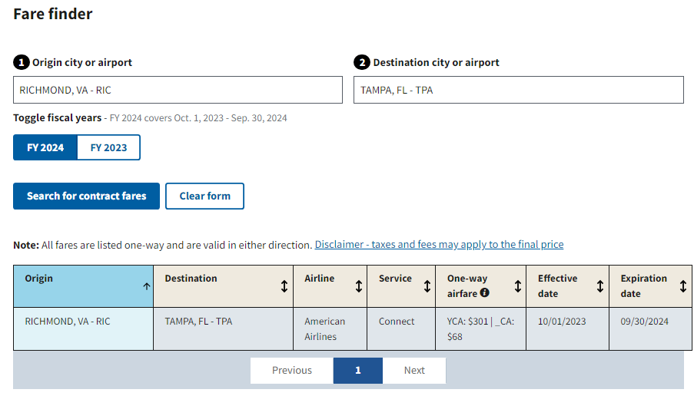
Constructed Travel Worksheet
Notes:
The previous screen reflected DCA at $201 and here Richmond is coming in at $301 and a limited capacity airfare of $68. However, if the traveler is not flying this information is not relevant to the preparation of this CTW.
Important note: If the traveler lives closer to RIC than DCA only DCA can be considered on the CTW per the Marine Corps Base Quantico Local Travel Order (MCBO 7220.1D)

Slide 16

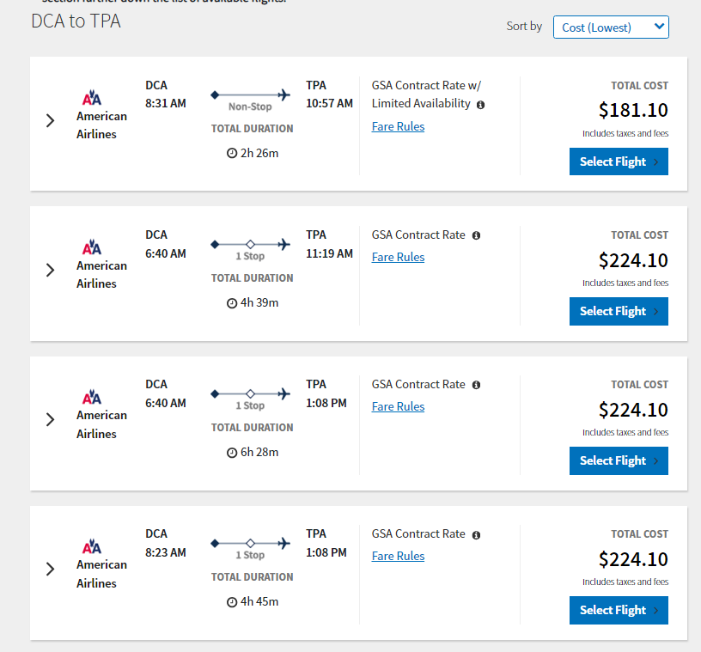
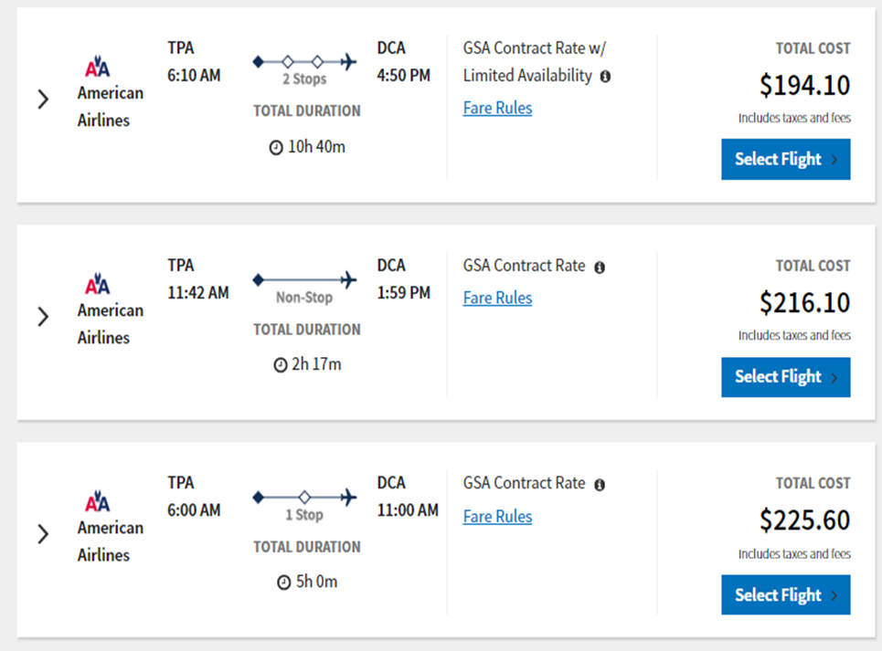
Constructed Travel Worksheet
Section 1
Search Result using DCA
Notes:
For our purposes today we will not pursue RIC and move back to the contract airport of DCA.

Slide 17

Constructed Travel Worksheet
Section 1
Search Result using DCA
Notes:
You can see on the screen, the lowest cost fare is $181.10 for DCA and $194.10 for TPA but we need to move past that because it shows w/ Limited Availability, known as a Dash CA (-CA) fare, which are not allowed to be used in constructed travel. This would be a disadvantage to the traveler for comparison purposes.

Slide 18

Constructed Travel Worksheet
Section 1
Search Result using DCA
Notes:
Instead, you want to use the YCA or contract airfare which reflects $224.10 down and $216.10 back. The amount of stops or layovers are not considered for comparison purposes. In our scenario roundtrip will come to $440.20. The CTO fee will always be the lowest cost of ($6.75) not the higher cost touch fee. Yes, inserting the higher cost touch fee is incorrect.
Keep the airfare and other screen shots and add to your CTW when uploading into DTS

Slide 19

Constructed Travel Worksheet
Section 1
Traveler must select the standard transportation mode (Air), not the mode being requested/used. And when selecting Air, the fare class (YCA) must also be added.
In this scenario the standard mode is air as the TAD/TDY location is more than 250 miles from the PDS.
Notes:
Once the traveler downloads and then opens the CTW they need to start filling it out. We’ll go section by section and break down where all the information comes from. It has been determined that DCA is the contract terminal, and the airfare cost (including taxes & fees) were obtained and now recorded in Section 1 of the CTW. The CTW will always be prepared to what the government would have incurred not what the traveler prefers.
In section 1 under “Mode” they will select the standard/directed mode of transportation which in this case is Air per JTR 0202. Each TAD/TDY will need to be considered on its own facts of the situation..
Each leg of travel will be it’s own line. Layovers are not a leg, it means PDS to 1st TAD location etc.
Next we will be moving on to Section 2.

Slide 20
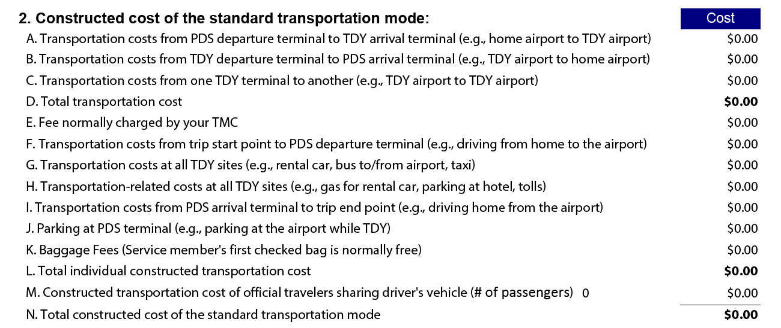

Constructed Travel Worksheet
Section 1
Notes:
This is a significant change from previous CTW. Any area not bolded is considered in this process, lets discuss them to eliminate confusion in this matter. 2A&B will auto feed from the information inputted in section 1. 2C would capture the cost if you were required to obtain transportation from one terminal to another. In our Tampa scenario, this will not be utilized. 2E represents the lowest cost of $6.75. 2F&I represent the mileage cost from home/PDS to the servicing terminal and return. For CTW you do not double the mileage there and back and must treat it as you would be parking at the terminal. 2G would represent rental vehicle cost, public transportation cost from the TAD/TDY terminal to your lodging/area where the duty would be performed. 2H would factor in additional cost such as fuel, parking at the lodging facility and tolls. 2J would account for parking at the departure terminal, use the economy lot price. 2K any bag fees incurred. 2M would contain a calculation if more than one traveler who will be riding with the traveler.
Note: The AO cannot direct anyone to use their POV or anyone else to ride in that POV. A traveler can voluntarily offer to let another traveler ride, never directed. Any injuries that occur would not be the responsibility of the government.

Slide 21
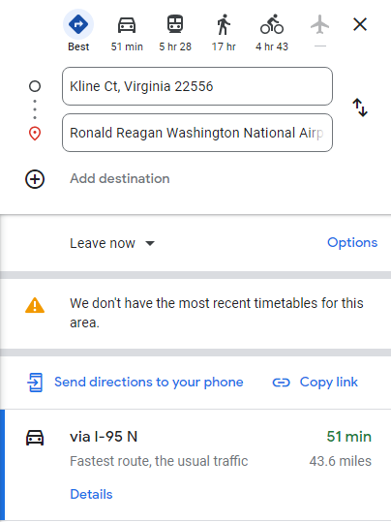

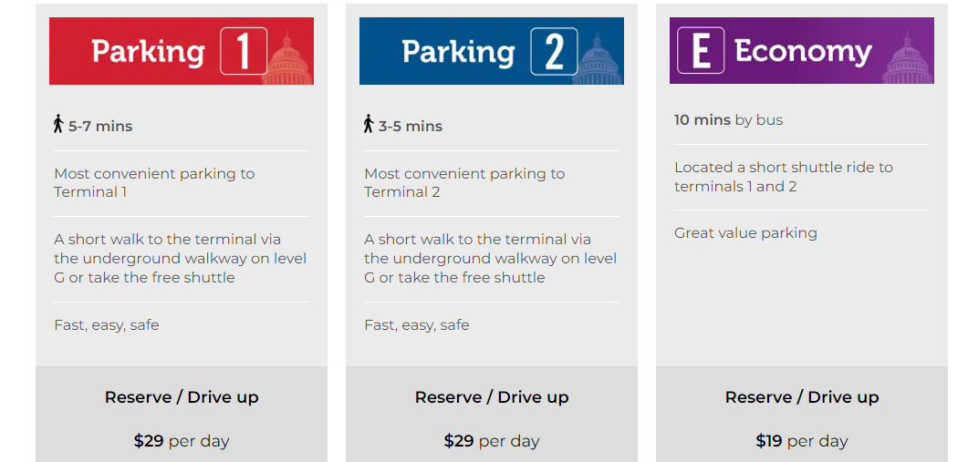

Constructed Travel Worksheet
Section 1
Notes:
To fill in the information you may use a variety of sources; screen shots of the YCA airfare from DTS, google maps or other mapping services to determine the distance from your departure point the servicing terminal, website containing the parking information at the servicing terminal, screenshots of the rental information found in DTS and other websites containing the information needed to complete section 2.
Past trends show people tend to take the easy way and do not gather this information. Not collecting this information prior to trip may result in a lower reimbursement.
For our scenario, the mileage each way to the servicing terminal is 44 miles and parking cost is $19 per day.
Keep the cost comparison screen shots and add to your CTW when uploading into DTS.

Slide 22
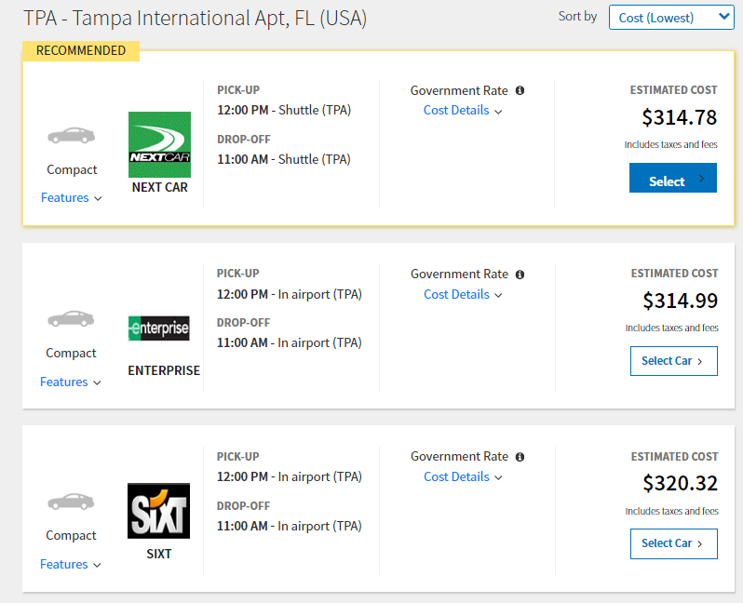
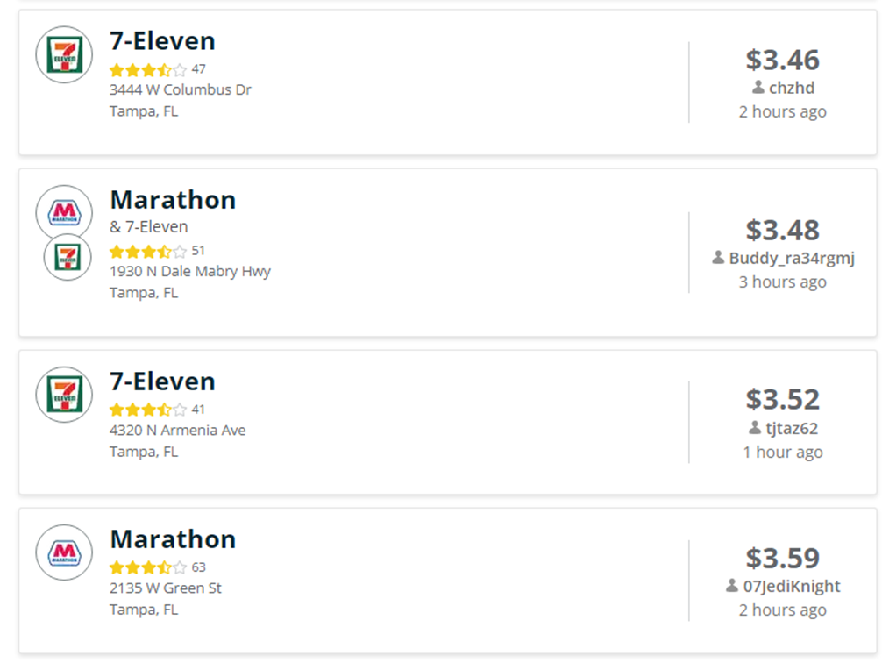

Constructed Travel Worksheet
Section 1
Search Result using TPA
Notes:
Obtaining a rental vehicle would cost $314.78 for the week. The lodging facility is 20 miles from the airport and 5 miles from where the TAD/TDY will be performed estimated minimum of 90 miles not including chow runs. Estimate 4 gallons at 3.51 (average from the screenshot above) for an estimate of $14.04.

Slide 23

Constructed Travel Worksheet
Section 2
Notes:
Upon obtaining the information we can start filling in section 2.
With section 2 completed it is now possible to see the total airfare cost in 2D, total avoided cost is displayed in 2L. 2M in this scenario is not utilized. 2N adds 2D & 2L and provides a reasonable cost of what the government would have incurred.
The amount in 2N is what will be compared to the cost of the traveler's preferred mode of transportation.

Slide 24
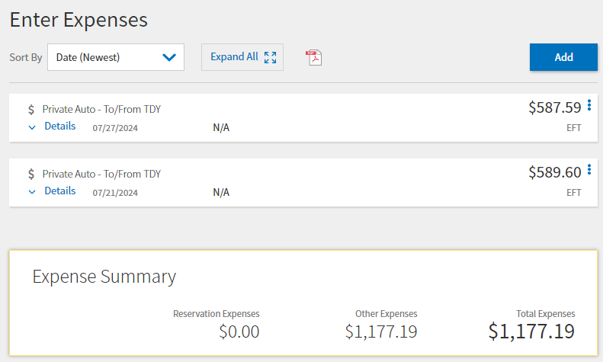
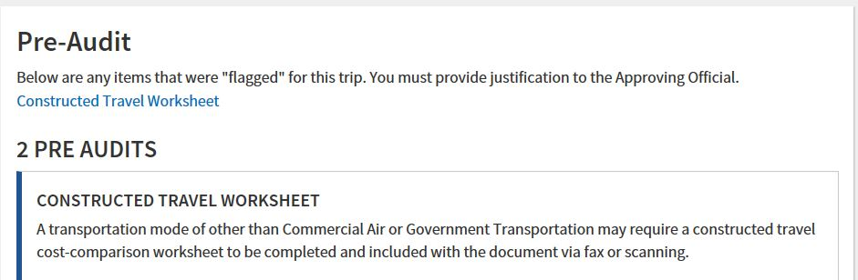
Constructed Travel Worksheet
  The Constructed Travel Worksheet (CTW) should be available when adding a mileage expense or in the Pre-Audit screen anytime a mode other than Air is shown on the authorization.
Notes:
Obtaining the cost to use the traveler’s preferred mode of transportation is to simply enter the information in the Expense tab of the authorization, must use zip code to zip code calculations, to obtain the associated round trip cost. The preferred mode in our scenario is driving and reflects a roundtrip cost of $1,177.19.

Slide 25
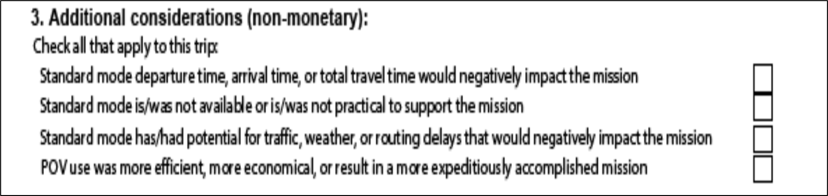
Constructed Travel Worksheet
Section 3
Section 3 is used to assist the AO in determining if requested mode is advantageous to the government
Highlights other non-monetary circumstances that may drive the AO’s decision
Cannot be a factor when Leave In Conjunction With Orders (LICWO) is involved
Notes:
Section 3 is available to address any non-monetary considerations. Any item checked here must be justified within DTS and may require additional documentation. (May read through some of the examples in section 3)
The Approving Official will need to consider all cost and non-cost factors, and then decide whether to authorize the traveler’s transportation mode, or to limit to the constructed cost.

Slide 26
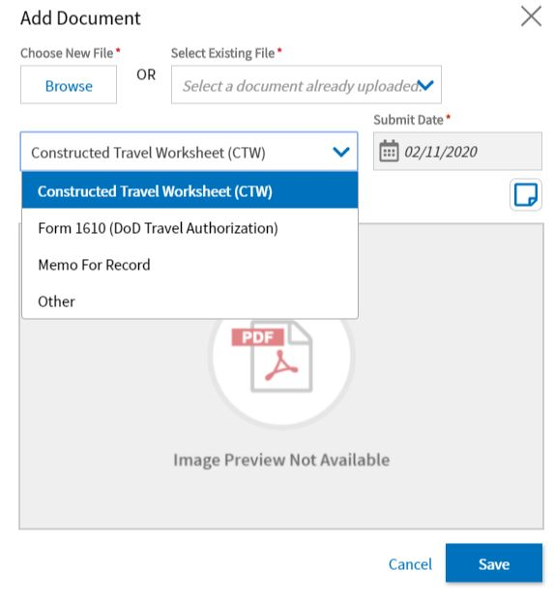
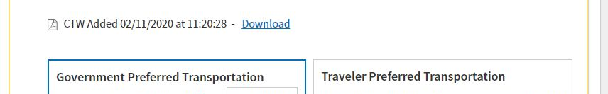
Constructed Travel Worksheet
The CTW must be loaded as that document type
Allows quick access for the AO in the Sign and Submit screen
Notes:
Once the traveler has completed the CTW, they will load it to their DTS authorization, making sure to load it as the correct document type. If they don’t load it correctly, The AO won’t be presented with the options they need in order to authorize it correctly. The right is what they will see in the Sign and Submit screen if it’s loaded correctly and can save the document from there instead of having to navigate to the Expenses screen to see it.
The upload will need to consist of the CTW and any supporting records reflecting the cost.

Slide 27

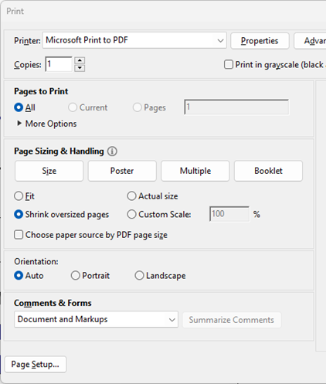
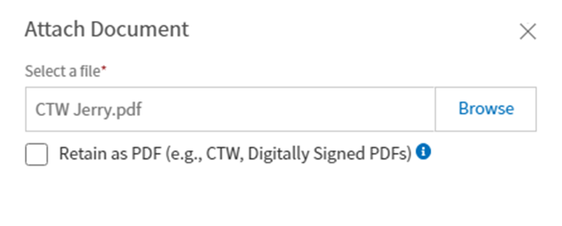

Constructed Travel Worksheet
Notes:
When preparing the CTW for upload it has been common for folks to see the “Please Wait” notification. If this is present on your voucher the CTW did not load correctly. To ensure this does not present problems on the voucher approval it is recommended that you print the CTW via the Microsoft Print to PDF option. This will disable the “Please wait…” problem. Finally, it is recommended to load as a PNG, by not selecting retain as a pdf. By not selecting retain as a pdf the document will be converted and you will know immediately if the document is readable. Otherwise, it will be necessary to view the pdf that was loaded to ensure it is viable.

Slide 28
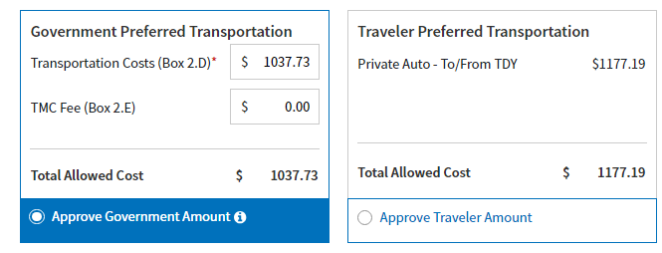
Constructed Travel Worksheet
AO must review the CTW and the provided supporting records
Once the AO determines the values are accurate, the AO will populate the Government Preferred Transportation block with the values contained in the CTW (block 2N) into the first block under Government Preferred Transportation
Traveler Preferred Transportation block is automatically populated by DTS based on proper Zip Code to Zip Code POV mileage values previously entered by the traveler & shown at the beginning of this scenario.
Notes:
When the AO attempts to approve there will be two boxes, one approving the Government Preferred Transportation on one approving the Traveler Preferred Transportation. In our scenario the traveler has requested to drive their POV to Tampa, FL for duty at MarCent. Using the standard mode of transportation within the JTR 0202 the Government’s cost would be $1,037.73 versus the Traveler’s preferred mode is $1,177.19. A difference of $139.46 with the lowest cost favoring the Government Preferred.
Before approving the AO should ask the traveler if they intend on stopping at alternate locations or driving straight through. Distance is 877 miles and by government standards that is at least 2 days of travel time. As the traveler is requesting use of the POV any additional travel days beyond one is at the cost of the traveler. In the event the traveler will take more than one travel day to arrive at the destination the authorization should reflect that day of departure vice the standard mode.
For example the traveler is required to be there on Monday morning, will take 2 days to travel there, the authorization should reflect leaving on Saturday, arriving on Saturday and then annotating Saturday as a leave, duty or non-duty day depending on the employment status. No per diem is payable for Saturday on the departure. Will need to repeat this for the return portion.
This is a necessary step and should not be overlooked, in the event an accident occurs the traveler will be on official orders.
Any and all additional cost associated with lodging or meals will be borne by the traveler beyond the preferred government option.
Any additional time needed to arrive at the destination beyond 1 travel day may subject the traveler leave or other administrative absence classifications.
In and around mileage would not be payable.

Slide 29
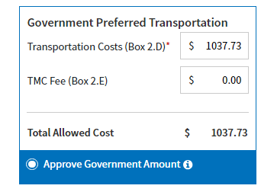
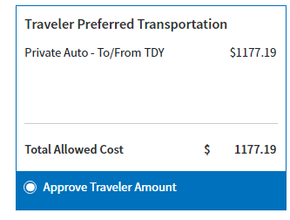
Constructed Travel Worksheet
Note: For vouchers, the choice is only presented to the Finance Office
Notes:
The unit AO will only see the CTW limitation screen on the authorization, Disbursing AO’s will see it on the vouchers.

Slide 30
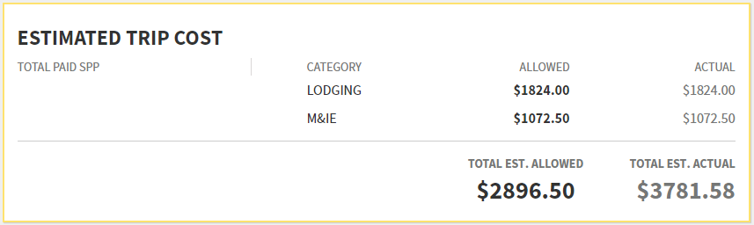
Constructed Travel Worksheet
When a document is Approved as Limited, the Actual and Allowed columns will be different
Notes:
This is what the accounting screen would look like if it was limited. These numbers don’t match the scenario, its just to illustrate that the actual amount is more than the allowed amount.

Slide 31
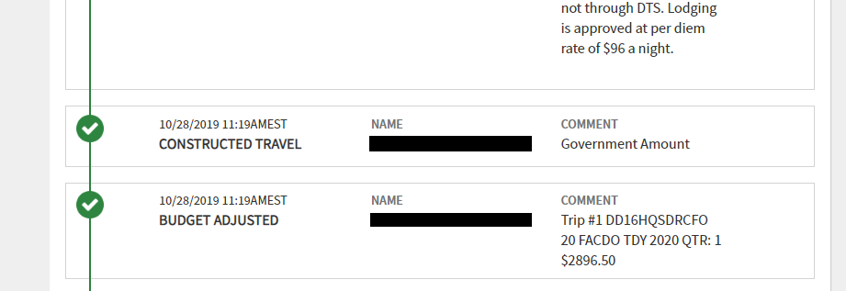
Constructed Travel Worksheet
When a document is Approved as Limited, the CONSTRUCTED TRAVEL stamp will appear in the history on the sign and submit page
Notes:
The digital signature screen looks like this if the AO limited your traveler to the constructed cost.

Slide 32

Question?
A traveler should complete a CTW every time a
POV is driven for TDY.
True or False?
Notes:
True. Recent changes to JTR 0202 have removed the 400-mile limit. CTW will be required any time a POV is used to complete TAD/TDY.

Slide 33
Question?
The constructed transportation cost is the cost of the
Directed transportation mode, minus taxes & fees
Traveler’s preferred transportation mode, including taxes & fees
Directed transportation mode, including TMC & related cost
Traveler’s preferred transportation mode, minus taxes & fees
Notes:
Correct answer is “C”, see instructions on how to complete the CTW.

Slide 34
Question?
If the AO does not authorize a transportation mode before a traveler departs, what authorized mode is implied?
Under 250 miles - rail, government auto, rental
Over 250 miles - Air
Traveler’s preference
Transoceanic - Air
Notes:
Correct answer is “A”,“B” & “D”, in the event the AO’s does not explicitly direct a mode of transportation the JTR does in paragraph 0202.

Slide 35
Question?
What is the traveler’s transportation reimbursement if the traveler did not use the authorized mode?
Traveler may always claim the full reimbursement
AO may limit to the cost of the authorized transportation mode
Traveler did not use the authorized mode, no reimbursement
Organization’s local policy determines limitation
Notes:
Correct answer is “B”, AO is required to comply with what is advantageous to the Government, JTR 010104.

