Slide 1
Voluntary Protection Programs (VPP) Fundamentals
Development, Validation, Implementation and Enhancement for a Voluntary Protection Programs Center of Excellence (VPP CX) Capability for the Department of Defense

Slide 2
Objectives
After this training you will be able to:
State why VPP is important to DoD and this workplace
Describe two levels of VPP recognition (Star and Merit)
State the benefits of VPP
State the four elements of VPP and an effective Safety and Health Management System
Describe your role in VPP.

Slide 3
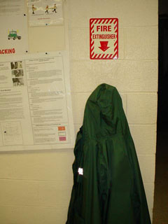
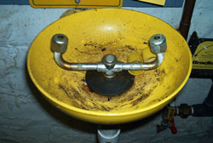
Ever See Anything Like this?
Notes:
Discuss with participants what is wrong with these images.

Slide 4
VPP Background
In 1982, the Occupational Safety and Health Administration (OSHA) developed VPP to recognize and promote effective worksite-based safety and health management systems.
Notes:
The Occupational Safety and Health Administration (OSHA) on July 2, 1982, announced establishment of the Voluntary Protection Programs (VPP) to recognize and promote effective worksite-based safety and health management systems. In the VPP, management, labor, and OSHA establish cooperative relationships at workplaces that have implemented comprehensive safety and health management systems. Approval into VPP is OSHA's official recognition of the outstanding efforts of employers and employees who have created exemplary worksite safety and health management systems. OSHA offers assistance to sites committed to achieving the VPP level of excellence.
The enabling legislation for VPP is Section (2)(b)(1) of the OSH Act, which declares the Congress's intent "to assure so far as possible every working man and woman in the Nation safe and healthful working conditions and to preserve our human resources B (1) by encouraging employers and employees in their efforts to reduce the number of occupational safety and health hazards at their places of employment, and to stimulate employers and employees to institute new and to perfect existing programs for providing safe and healthful working conditions. . ."

Slide 5
Why VPP in DoD?
Preventable injuries and illnesses cost the DoD an estimated $10 to $21 billion annually, according to the National Safety Council.
“Our goal is zero preventable accidents, and I remain fully committed to achieving the 75% accident reduction target in 2008 “- Secretary of Defense 2007

Slide 6
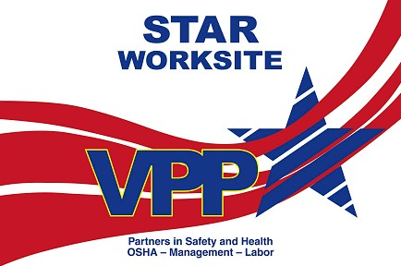
OSHA VPP Programs
VPP compares YOUR Safety and Health management system to key elements found in the BEST S+H management systems.
Program Levels:
– Star – Highest level of recognition
All VPP Elements/Sub-elements in Place
Injury and illness rates below the national average.
– Merit – Working toward Star
Some Elements/Sub-elements may not be in place
Rates may be above national average
Sets time limit for achieving Star.
Notes:
Merit status is a temporary state. A site cannot enter into the VPP with the expectation that they will maintain Merit status; the intent is to continuously improve and ultimately achieve Star status.

Slide 7
DoD Star and Upcoming Star Sites
NIMF Pacific NW
Naval Region NW Everett
NSY Puget Sound
NAVFAC NW
AFNG 148th Fighter Wing
COGO Umatilla
115 Fighter Wing
NSY Portsmouth
Tobyhanna Army Depot
Hanscom AFB
88 Medical Group Wright Patterson AFB
WPAFB AERO Systems
Aviation Support Facility
at Fort Indiantown Gap
COGO Rocky Mtn. Arsenal (2) Commerce City
DLA Columbus
DGMC, Travis AFB
Crane Army
Ammunition Activity
88th Air Base Wing
USAG – Fort Detrick
Rocky Mtn. Arsenal
NSA SDD Fort Meade
NSA MTSO Fort Meade
Blue Grass AD
NSY Norfolk
97 Maintenance Group, Altus AFB
McAllister Ammunition Plant
USACE Louisville District
MCLB Barstow
Pine Bluff Arsenal
402nd MXW/SMXG Robins AFB
COGO Anniston
NWS Charleston
Ft. Gordon
NSY Pearl Harbor
SERMC Mayport
SB Kings Bay
NS Mayport
NSA Wiesbaden, Apo, AE
NAS Jacksonville
USAG - Kaiserslautern
Corpus Christi AD
NSA Stuttgart, Apo, AE
29 Star Sites
Naval Health Clinic Corpus Christi
4 Recommended Star Sites (includes 1 Merit Site)
11 Potential Star Sites
NAS Key West

Slide 8
VPP Benefits
Improved safety and health for workers
Average injury/illness rates of VPP Star sites are 52% below those of their industry peers.
Cost savings
Lost time and property
Disruption and lost productivity
Medical treatment
Workers compensation.
Improved morale and productivity.
Notes:
Benefits of VPP attainment at military installations can include:
Increases in available end strength, which positively affects force readiness
Improvements in employee morale & worksite productivity
Increased understanding of safety & health requirements, providing supervisors & employees with focus & direction
Improved lines of communication, which provide better opportunities for feedback
Increased knowledge sharing within & between military services, agencies & private sector
Please be sure to acknowledge that it is very common for sites to experience an initial SPIKE in their injury rates as they begin working toward VPP. Correlated to increased communication and awareness about the importance of injury (and near miss) reporting. It isn’t the injuries that are increasing, but the reporting of those injuries.

Slide 9
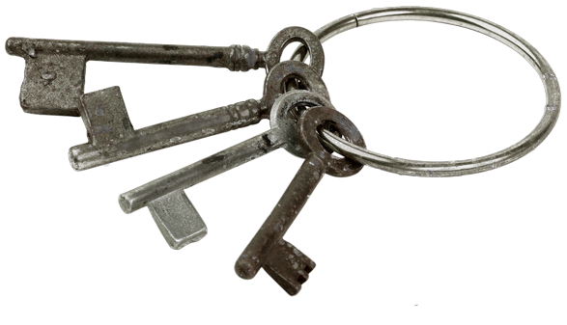
Keys to VPP Success
Look at Safety and Health in a different way
It’s not a program, it’s a core value
It’s not just meeting requirements - it’s eliminating hazards
“We don’t do it until we can do it safely.”
Managers are committed to worker safety.
Notes:
Other items to possibly touch upon is the culture being the key and creating a supportive atmosphere to foster safety as a core value.

Slide 10
Keys to VPP Success
Involve workers in finding hazards and making decisions:
They know where the hazards are
They know what works for them, and what doesn’t.
Union support
Empower everyone to see, report, act
Pursue systematic continuous improvement.
Notes:
Other items to possibly touch upon is the culture being the key and creating a supportive atmosphere to foster safety as a core value.

Slide 11
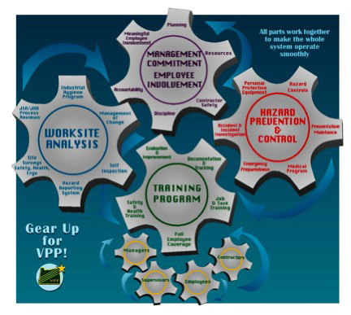
VPP Elements
VPP is a process, a culture, not an inspection.
There are four main elements to this process:
– Management Leadership and Employee Involvement
– Work Site Analysis
– Hazard Prevention and Control
– Safety and Health Training.

Slide 12
Management Leadership
Managers lead the way by:
Making safety expectations clear to all (policies, goals, objectives, responsibilities, assignments)
Creating ways for workers to be heard on safety and health issues (committees, self inspections, reporting systems, etc.)
Allowing time for safety activities
Setting an example
Ensuring workers and contractors are provided high quality safety and health protection.
Notes:
Critical concept:
Assigned accountability is essential in triggering a culture change. Having responsibilities identified is only part of the equation. Leadership and employees must be able to recognize what it means to fulfill those responsibilities… and having defined measurable goals and objectives is necessary to establish clear accountability.

Slide 13
Employee Involvement
Employee involvement in at least three meaningful ways:
Participating in safety and health committees, events, reviews, inspections, investigations, etc.
Learning about the safety and health management system, and sharing that knowledge with others
Reporting hazards and submitting ideas for improvement
Participating in the development or review of Job Hazard Analyses
Awareness of the installation’s VPP participation
Understanding the basic principles of VPP.

Slide 14
Work Site Analysis
Analyze safety and health hazards such as:
Safety Office inspections
Industrial Hygiene Surveys
Job Hazard Analysis
Prior review of new processes
Investigate mishaps and near misses
Routine self inspections.
Notes:
May want to emphasize that this is clearly NOT a regulatory requirement, but it is a MINIMUM requirement of VPP.
The employer must use a JSA or any equally effective method for conducting a hazard analysis. The employer may use ANY system for hazard analysis as long as it: adequately identifies the hazards of the job, documents the hazards, and ensures tracking of identified hazards to correction in a timely manner.

Slide 15
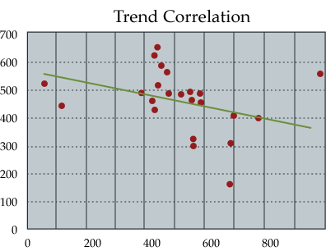
Work Site Analysis
Report and record hazards
Track until completed.
Analyze data and trends
Mishaps
Near misses
Hazards found in inspections, self- inspections
Hazards reported by employees.
Notes:
May want to emphasize that this is clearly NOT a regulatory requirement, but it is a MINIMUM requirement of VPP.
The employer must use a JSA or any equally effective method for conducting a hazard analysis. The employer may use ANY system for hazard analysis as long as it: adequately identifies the hazards of the job, documents the hazards, and ensures tracking of identified hazards to correction in a timely manner.

Slide 16
Hazard Prevention and Control
Hazard Prevention and Control includes:
Access to qualified safety and health professionals
Access to qualified medical/health professionals
Utilizing control measures, such as:
Preventive maintenance of facilities and equipment
Emergency systems (drills, training, response).
Hazard controls are understood, followed and enforced.
Improved process design Hazmat substitution or elimination Confined space access controls | Lockout/tagout Machine guards Personal protective equipment.

Slide 17
Safety and Health Training
Safety and Health Training includes:
– Hazard recognition
– Worksite hazards
– Signs and symptoms of workplace related illnesses
– Job specific hazards
– Protective measures
– Personal protective equipment
– Emergency evacuation
– Employee rights under OSHA
– VPP fundamentals.
Notes:
Example for Hazards at the site: Job Safety Analyses, Job Hazard Analyses, etc.
Example of Protective Measures: PPE, process specific hazard controls, etc.
Example for Emergency evacuation: Evacuation route, where to assemble after evacuation, etc.
Example for Employee Rights under OSHA: OSHA Hazard Communication Act (Worker Right to Know), injury/illness reporting, etc.
Example for VPP: Fundamental Principles of VPP, and the right to file a complaint
Some other General Training Program Requirements include:
– Attendance must be documented
– Frequency must meet OSHA standards
– Additional training is required for changes in processes, new equipment, new procedures, etc.
– Curricula must be up-to-date and specific to worksite
– Curricula must be modified for changes in worksite, hazards, controls, etc.

Slide 18
Summary
In this session you learned about:
Why VPP is significant
Two levels of VPP recognition (Star and Merit)
The benefits of VPP
The four elements VPP and an effective Safety and Health Management System.
The employee’s role in VPP.

Slide 19
Questions?

