Slide 1
INTRODUCTION TO STORM WATER
What is storm water? Storm water is defined as surface runoff, primarily from rain, but also snow melt and other forms of precipitation. The Environmental Protection Agency and the Commonwealth of Virginia have established stringent regulations on how storm water must be managed. These regulations impact the job you do on a daily basis, so it is important to be aware of them.
Storm water is an important environmental concern. As storm water flows across the ground, off of a roof, or through a parking lot, it can pick up various pollutants such as oil, grease, spilled materials, and other debris. In addition, storm water can also pick up eroded soil from construction sites.

Slide 2
All storm water runoff at Quantico eventually discharges into the Potomac River, which itself drains into the Chesapeake Bay. Although discharged in relatively small quantities, over time these pollutants and eroded soil can harm our surface waters and affect our environment, our economy, and overall quality of life. For example, polluting the Chesapeake Bay can harm plant and animal life, impact the commercially important seafood catches from the bay, and harm its recreational quality.

Slide 3
Storm water regulations and environmental impacts from storm water make it important for you to be aware of the basic principles of storm water management and take a role in preventing storm water impacts. It is also important to understand the relationship between your daily activities and storm water quality. Many of the solutions to storm water pollution rest on the decisions and actions that you take on a daily basis. For example, it is illegal to discharge any chemicals or materials other than storm water into a storm drain. Therefore, it is important for you to properly dispose of any used chemicals or spilled materials that could impact storm water. Before these regulations came into effect, it was acceptable to let the water from washing vehicles go down the storm drain. The current storm water regulations expressly prohibit such activities in industrial areas.

Slide 4
STORM SEWER VS. SANITARY SEWER
It is important to understand the difference between the storm sewer and the sanitary sewer. Although they appear to be the same, there are some very important differences that you need to know about.
Waste water that leaves your work building or house, such as through a bathroom or kitchen sink, is discharged through the sanitary sewer system. Every building at Quantico that contains plumbing is connected to the sanitary sewer. The waste that goes down these pipes drains to a sewage treatment plant. The treatment plant is designed to treat and remove pollutants and sewage from the wastewater before it is discharged to the Potomac River. Although the treatment plant is designed to remove pollutants, it cannot remove all pollutants such as solvents or oils, which is why you should not discharge these types chemicals into the sink.

Slide 5
The storm sewer is also a collection of underground pipes, but these pipes drain storm water directly into the Potomac River or one if its tributaries without removing any pollutants. Therefore, if you dump a quart of oil down the storm sewer, that quart of oil will drain directly into the river.
How can you tell the difference between a storm drain and a sanitary drain? A good rule of thumb is that any drain inside a building, such as a sink or floor drain, will lead to the sanitary sewer system. Any drain outside a building, such as a storm drain or storm grate, will drain into the storm sewer system.

Slide 6
DID YOU KNOW:
Storm water discharges are often the #1 source of water pollution in the U.S.
One quart of oil can contaminate 250,000 gallons of water.
One pint of motor oil can produce an oil slick one acre in size.
Nutrients, primarily nitrogen and phosphorus, carried into the Chesapeake Bay by storm water runoff from agricultural lands can create algal blooms. Algal blooms can cut off light for Bay organisms such as underwater grasses. Decaying algae can remove dissolved oxygen from the water, turning large sections of the Bay into dead zones.
A typical city block generates 9 times more storm water runoff volume than a woodland area of the same size.

Slide 7
These are just a few of the facts indicating that storm water runoff contributes significantly to the pollution of our nation's surface waters. Each of us must do our part in controlling discharges of pollutants into storm water runoff. Awareness of this issue and recognition of its adverse impacts on the environment and quality of life is the first step towards solving the problem. After completing this course, it is important that you not only apply what you have learned both at work and at home, but also share this beneficial information with your family, particularly your children

Slide 8
SO HOW DOES YOUR WORK AFFECT STORM WATER?
There are various types of contaminants that can come into contact with storm water runoff. There are also various ways those contaminants may enter the storm drain system. It is important to look around your facility and identify what potential sources of storm water pollution may exist. Let’s look at some of the common pollutants here at Quantico.

Slide 9
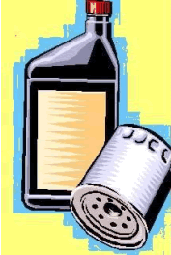
PETROLEUM
One of the most common sources of storm water pollution at industrial sites is petroleum, such as oil, grease, or fuel, leaking from equipment and vehicles (e.g. fork lifts). Many leaks or drips go unnoticed and result in staining of the pavement. During storm events, runoff becomes contaminated with the oil, grease, or fuel. Oil-contaminated runoff is often evidenced by a bluish sheen, or "rainbows," on top of the water

Slide 10
WASH WATER
Water used to wash vehicles, equipment, floors, etc. should not ever be allowed into a storm drain. This water not only contains soap, but can also contain various other chemicals, such as petroleum, heavy metals, oil and grease. All wash water disposal should be directed to the sanitary sewer

Slide 11
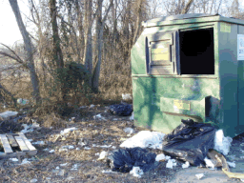
TRASH
Obviously, the storm drain system isn’t a place for trash. But if you litter outside, eventually that’s where that litter is going to go—into the storm drain and out to the river! All trash, including cigarette butts, bottles, etc., should be properly disposed of in a CLOSED trash container. If the container is left open, the purpose is kind of defeated. Not only can storm water get into the container and wash out pollutants, open trash containers are also great attractors of insects, animals and birds.

Slide 12
SEDIMENT
Believe it or not, one of the most serious problems in the Chesapeake Bay right now is sediment. Dirt coming off of construction sites, agricultural operations, forestry and natural erosion is one of the three biggest pollutants we have today (the other two are nutrients—phosphorous and nitrogen).
We usually don’t think of sediment as a “pollutant,” but it is. Too much sediment in the river can clog fish gills and lead to suffocation. It can also suffocate plants and fill in areas with large sediment deposits, thereby disrupting the normal flow of the river. If you would like to learn more than you probably ever wanted to know about sediment, check out the “Construction” module after you finish this session.

Slide 13
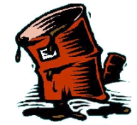
CONTAINER STORAGE
Improper storage of drums and other containers is a common source of storm water pollution. All containers should be stored within secondary containment and either covered or kept inside a building. If containers are not stored properly, leaks or spilled materials may be washed into the storm drain.

Slide 14
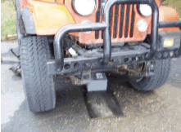
VEHICLE MAINTENANCE AND STORAGE
Vehicles stored outside can drip fuel and oil, as previously mentioned. Drip pans should be provided for these vehicles instead of letting them drip on the ground. Deadlined vehicles should be drained of all fluids, and the fluids disposed of properly. Vehicle and equipment maintenance performed outdoors can also cause pollution. All vehicle maintenance should be performed indoors to reduce the chance of fuel leaks and spills and improper disposal.

Slide 15
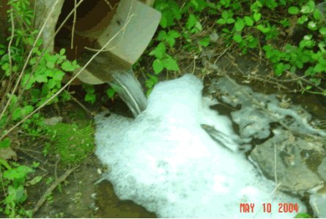
Now for the fun part!! Check out the following pictures. If you think that the pollution prevention procedures are good, click on the GOOD button, if they stink, or need some work, click on the BAD Button!
Here’s the first picture:

Slide 16
Correct! There are suds coming out from this outfall. This particular incident stemmed from where a group was conducting a charity car wash in an unauthorized area. Soap can harm the water in many ways. Just as you use soap to wash grease and oils from your body, it will also wash oils off of fish. Unfortunately for the fish, they need this oily coating to protect themselves.
Soap probably doesn’t taste that great to the fish either.

Slide 17
WRONG!!! Take a closer look at the picture and try again!!!!

Slide 18
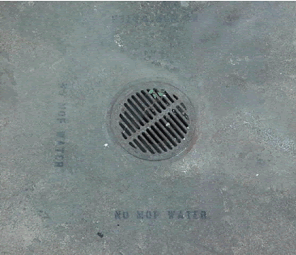

Slide 19
WRONG!!! Take a closer look at the picture and try again!!!!

Slide 20
Correct! This is a great way to remind folks not to dump mop water down a storm drain. Clearly stencil around the drain a message, such as “No Mop Water—Drains to River!”

Slide 21
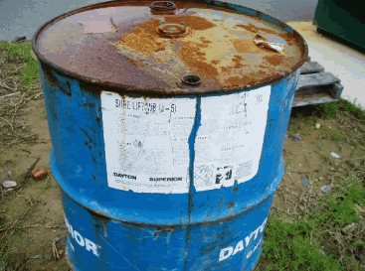

Slide 22
WRONG!!! Take a closer look at the picture and try again!!!!

Slide 23
Correct! This drum is in bad condition AND it has been stored outside on the grass. No cover, no secondary containment, and it looks as if the bung holes on top might be open as well. A BIG no-no

Slide 24
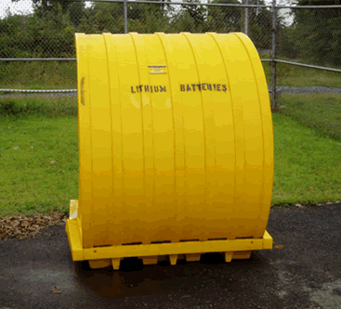

Slide 25
WRONG!!! Take a closer look at the picture and try again!!!!

Slide 26
Correct! The used batteries here have both secondary containment and are covered securely. Rain will not get on these batteries!! And the container is labeled too!

Slide 27
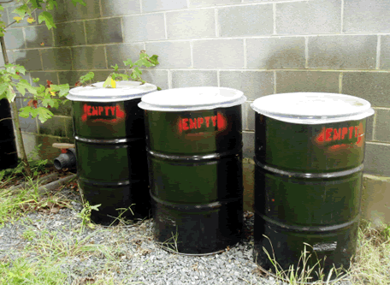

Slide 28
WRONG!!! Take a closer look at the picture and try again!!!!

Slide 29
You are right!! These barrels are empty (as noted by the stencil on the side—and I checked them too.) Not only are they empty (so they don’t need to be in secondary containment), but they still have drum covers to keep the rain from rusting out their tops.

Slide 30
Now that you have finished the module, it is time to take THE DREADED TEST. Don’t worry—you can’t fail it. If you select the wrong answer, a screen will show up telling you why it is the wrong answer, then you can try answering the question again.
At the end of the test, don’t forget to print out your certificate for your records!!

Slide 31
QUESTION 1 OF 10
Which of the following common pollutants currently causes the most problems in the Chesapeake Bay? (click on the corresponding letter)
A
Sediment
B
Oil
C
Sewage Treatment Plant
D
Detergents

Slide 32
NOPE!
While oil that drips from vehicles does cause a problem, it is not the most significant pollutant today.

Slide 33
NOPE!
Sewage Treatment Plants actually help to clean dirty water before it gets into the river. The only time the plant may cause pollution is when it has an overflow. Then, thousands of gallons of sewage have the potential of polluting the river. Luckily, this hasn’t happened at Quantico for a very long time. The one problem we do have are sewage spills from overflows in the sewage pipelines. These overflows can be caused by breaks in the line, clogged lines, power failure at pumping stations, etc. A report of these spills must be turned in to state authorities within 24 hours of the spill event.

Slide 34
NOPE!
We definitely don’t want detergents getting into the river, but this is mostly a small occurrence. For example, all approved vehicle wash areas on base drain to the sanitary sewer instead of the storm drains, so only occasionally do we have problems with illegal vehicle washing.

Slide 35
CORRECT!
Almost 425,000 dump truck loads of sediment get into the Chesapeake Bay every year from storm water runoff alone!!
The main culprits are:
Crop and pastureland erosion (63%) Urban runoff (especially from construction sites) (20%) Forestry Natural erosion

Slide 36
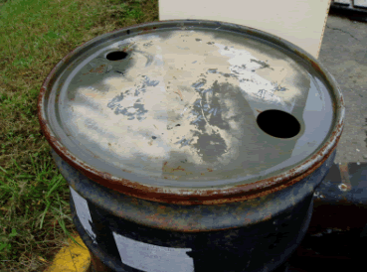
QUESTION 2 OF 10
What is wrong with this picture?
A
Drum is open
B
Drum is unprotected from rain events
C
Drum is not in secondary containment
D
All of the above

Slide 37
YOU ARE PARTIALLY CORRECT!! TRY AGAIN!

Slide 38
CORRECT!
Although it may be hard to see, this drum is just sitting on the ground with no secondary containment to catch a spill should the drum tip over or should it overflow during a rain event.
The bung holes are open, so rain water can enter the drum and mix with the contents. The drum is definitely unprotected from any rain event. To protect it, it should be sealed and have either a drum cover or be placed inside a storage containment system.

Slide 39
QUESTION 3 OF 10
Name a potential polluting activity NOT normally done at Quantico
A
Aircraft Maintenance
B
Fueling Operations
C
Agriculture
D
Construction

Slide 40
YA GOTTA BE KIDDING!
Of course we do this!! We’ve even got the President’s helicopters to prove it!!!

Slide 41
YOU BET WE HAVE FUELING OPERATIONS!
Fuel, whether it be gasoline, heating oil, diesel, or JP-8, is one of the biggest types of chemical we store here at Quantico. And it’s imperative that we keep the fuel from getting into the storm drain system. Here are a couple of helpful hints that you now have to read because you clicked on the wrong answer:
Never top off your vehicle when filling it. This can lead to a spill.
All fueling points on base must have a spill kit handy at the site.
Loading and unloading of fuel shouldn’t take place during a storm event unless absolutely necessary.
Someone should be on-hand AT ALL times when fueling vehicles, as well as when filling up tanks. Don’t walk away, or there could be a spill on your hands!!!

Slide 42
INCORRECT!
Good golly, there’s construction going on all over this base. All the housing is brand spanking new (most of it anyway) and we’re getting a new hangar, and the ranges are being redone, and don’t forget about all the people moving in eventually from the BRAC thing. We’re gonna be swamped with construction for the next few years.
And what’s the biggest pollutant from construction sites? That’s right—SEDIMENT.

Slide 43
CORRECT!
We do very little agricultural (farming) work here at Quantico. There are some areas on the west side of base where we’ve planted some corn for the deer to eat, but that’s about it.

Slide 44
QUESTION 4 OF 10
Which example is NOT a source of storm water pollution?
A
Open garbage can
B
Covered drums stored in secondary containment
C
Used car batteries stored outside on pallets
D
Leaking fire hydrant

Slide 45
INCORRECT!
Not only are they a great attractant for animals, vermin like rats and raccoons, and insects, but an open trash can can fill up with water during a rain event and overflow. And even if it doesn’t overflow, you’ve just created a wonderful mosquito nursery!

Slide 46
INCORRECT!
Used batteries can leak acid, which can be VERY bad if it gets out into the river! Batteries need to be kept under cover and stored in secondary containment.

Slide 47
NOPE
Fire hydrants just contain water right? This shouldn’t be a problem, should it? WRONG! Potable (drinkable) water contains chlorine to kill any bacteria in the water. Unfortunately, chlorine can also kill fish. Large amounts of chlorinated water entering the river can result in fish kills, and are actually considered reportable spills.

Slide 48
CORRECT!
That’s the nice way to store drums--covered and with secondary containment. You should also make sure that the drum lid is secure and that the drum is properly labeled.

Slide 49
QUESTION 5 OF 10
True or False:
Salt spread on the roads during winter is a pollutant.
True
False

Slide 50
THE CORRECT ANSWER IS TRUE.
An excess of salt can raise the salinity in the water and kill fish that normally wouldn’t live in a salty environment. While salt must be used on ice as a safety precaution, only the bare minimum should be used, and the salt must be stored in a covered area (like a salt dome) when it is not being used.

Slide 51
QUESTION 6 OF 10
True or False:
As a Federal facility, we are exempt from most regulations.
True
False

Slide 52
The correct answer is FALSE.
Federal facilities aren’t exempt by regulations created by the Environmental Protection Agency (EPA) and all the storm water regulations come from them. The Commonwealth of Virginia is granted the authority by EPA to uphold the regulations, so we are reportable to both Virginia and the EPA.

Slide 53
QUESTION 7 OF 10
Where should you dump your mop water?
A
In the nearest outside drain
B
Down an indoor deep sink
C
Into the river
D
In a graveled area

Slide 54
INCORRECT!
Almost every drain you see outside goes directly to the river. Mop water is full of pollutants—soap, dirt, oils—and cannot be dumped down an outside drain

Slide 55
NO, NO!!! GO BACK AND ANSWER AGAIN!! I CAN’T BELIEVE YOU EVEN PICKED THIS ONE!!!
NEVER dump mop water into the river. Of course, if you dump the mop water down a storm drain, you’re practically doing the exact same thing, so you can rule out answer A also when you get back to the question!!!

Slide 56
WELL, MAYBE BUT...
If there’s no other place to dump it, a gravelly area is probably your best bet. Either that or a grassy area where the water can percolate into the ground. But your ABSOLUTE best bet is down an inside drain. Now that I’ve given you the answer, go back and click on it.

Slide 57
CORRECT!
Practically all indoor drains lead to the sewage treatment plant, where the polluted water can be treated.

Slide 58
QUESTION 8 OF 10
What are some of the outcomes of poor storm water pollution prevention?
A
Dead fish
B
Fines or Notices of Violations
C
Un-swimmable river
D
All of the above

Slide 59
YOU ARE PARTIALLY CORRECT!! TRY AGAIN!

Slide 60
CORRECT!
Pollutants can kill aquatic vegetation and wildlife. And if the fish can’t live in it, you probably wouldn’t want to swim in it (ewww!)
Regulatory agencies can also give fines or notices of violation if we pollute the river.

Slide 61
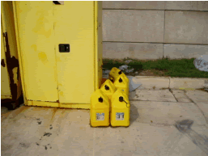
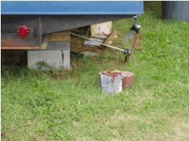
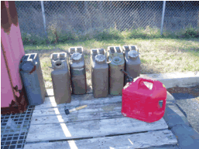
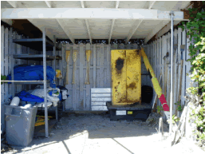
QUESTION 9 OF 10
Which of these pictures shows the BEST storm water pollution prevention practices? (Click on the correct picture)

Slide 62
Nope Try AGAIN!
Paint containers sitting out in the grass??

Slide 63
Incorrect!
This fuel is stored outside on pallets. No secondary containment!! Plus, some of these containers are open. A good rain event could fill these containers up and overflow whatever’s inside.

Slide 64
Nope
Nope. These containers are sitting on the ground with no secondary containment. You can’t really tell from the picture, but they are outside as well

Slide 65
Correct!!
Out of all these pictures, this is the best. The locker containing hazardous materials is not only under cover, but is on a secondary containment unit as well.

Slide 66
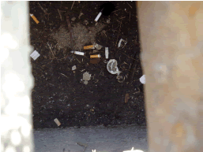
QUESTION 10 OF 10
Which of these pictures is NOT a good example of storm water pollution prevention practices?

Slide 67
Incorrect!
SORRY!! This is a GOOD preventive procedure—marking storm drains with stencilled messages, such as “No Mop Water” or “Do Not Dump—Goes to River.”

Slide 68
Incorrect!
This is a GOOD preventive procedure--stenciling “EMPTY” on empty drums and still covering the tops with drum protectors. These drums do not need to be in secondary containment because they are empty, but since rain can still rust the tops of these drums, it is important to use the drum covers to protect the tops.

Slide 69
Nope!
This is a very GOOD way to store batteries—in secondary containment and covered..

Slide 70
Correct!!
Out of all these pictures, this is the best. The locker containing hazardous materials is not only under cover, but is on a secondary containment unit as well.

Slide 71
MCB Quantico
Certificate of Completion
Industrial Storm Water Training Course
is hereby granted to:
Name: ________________________
Facility:_______________________
Date: _________________________

