Slide 1
EPAR
(Electronic Personnel Administrative Request)

Slide 2
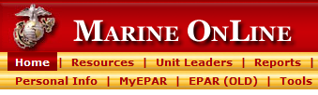
EPAR
(Electronic Personnel Administrative Request)
EPAR System Applications
  My EPARs
    This application is used by the individual member and is located in MOL under the Home tab.
    The new EPAR application will be labeled “My EPAR” and the old application will be labeled “EPAR (OLD)”.

Slide 3
EPAR
(Electronic Personnel Administrative Request)
Viewing EPAR Records
My EPARs
  The user can view all EPARs that he or she has submitted, whether the EPARS are closed, located in the unit (Unit EPARs), or located in the IPAC (Admin EPARs).
Unit EPARs
  The user can view all EPARs in their respective unit (RUC), whether the EPAR is closed or located with the member (My EPARs), unit (Unit EPARs), or IPAC (Admin EPARs).

Slide 4
EPAR
(Electronic Personnel Administrative Request)
Creating EPAR Records
All users can create an EPAR record and save it as a Draft.
My EPARs
  The user can only create an EPAR.
  If My EPARs user is assigned (attached or joined) to more than one unit (RUC), the user can select the applicable unit.

Slide 5
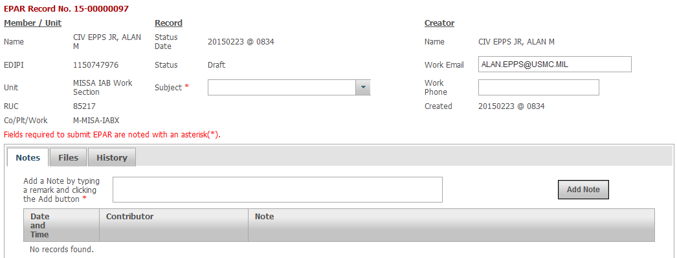
EPAR
(Electronic Personnel Administrative Request)
Creating EPAR Records (Continued)
My EPARs Example
RANK LAST, FIRST M.
1234567890
1ST COMBAT BN
12345
A-BCDE-FGHI
20150301 @ 0700
RANK LAST, FIRST. M.
FIRST.LAST@USMC.MIL
20150301 @ 0700

Slide 6
EPAR
(Electronic Personnel Administrative Request)
Submitting and Retrieving EPAR Records
The EPAR is automatically routed between the MOL and UDMIPS, when a user “submits” or “retrieves” the EPAR record.
  Member ←→ Unit ←→ IPAC/PAC
  (My EPARs) (Unit EPARs) (Admin EPARs)
My EPARs - The user can submit an EPAR to the unit (Unit EPARs) and retrieve an EPAR record from the unit (Unit EPARs), if the unit has not already assigned the EPAR.

Slide 7
EPAR
(Electronic Personnel Administrative Request)
Closing and Reopening EPARs
  The EPAR will automatically “close”, if the member is no longer assigned to the unit that generated the EPAR (RUC). In addition, the EPAR cannot be “reopened”.
My EPARs - The user can close and reopen an EPAR, if the EPAR was created by the member.
Unit EPARs – The Approver and Active Reviewer user can close and reopen an EPAR, if the EPAR was created by the member or the unit.
Admin EPARs – The Certifier, Reviewer, and Preparer can close and reopen an EPAR, if the EPAR was created by the member, a supported unit, or the IPAC.

Slide 8
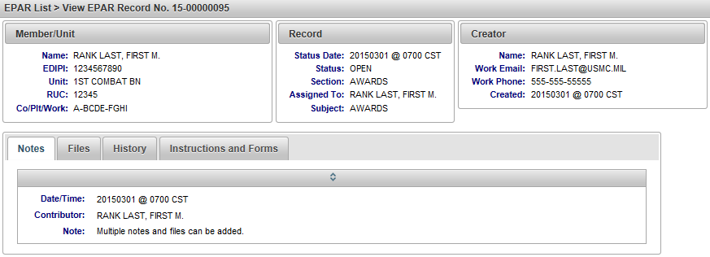
EPAR
(Electronic Personnel Administrative Request)
Editing EPARs - The EPAR can only be edited in the application it is located (MOL or UDMIPS). Admin EPARs “View Only” example
Number
(automatically populated and cannot be edited)
Member’s information (editable in Unit EPARs
and Admin EPARs only)
Unit’s information
(editable in My EPARs
and Admin EPARs only)

Slide 9
EPAR
(Electronic Personnel Administrative Request)
Editing EPARs Admin EPARs “View Only” example
Status
(editable in Unit EPARs
and Admin EPARs only)
Status Date
(automatically updated
and cannot be edited)
Section
(editable & only displayed in Admin EPARs)

Slide 10
EPAR
(Electronic Personnel Administrative Request)
Editing EPARs Admin EPARs “View Only” example
Subject
(editable and displayed
in all applications)
Assigned
(editable and only displayed in Unit EPARs and Admin EPARs)

Slide 11
EPAR
(Electronic Personnel Administrative Request)
Editing EPARs Admin EPARs “View Only” example
Created
(automatically populated and cannot be edited)
Work Email and Phone
(editable and displayed in all applications)
Creator’s Rank & Name (automatically populated and cannot be edited)

Slide 12
EPAR
(Electronic Personnel Administrative Request)
Editing EPARs Admin EPARs “View Only” example
Notes
(multiple notes
can be added)
Files
(multiple files can be added or removed)
History
(automatically populated and cannot be edited)

Slide 13
EPAR
(Electronic Personnel Administrative Request)
Editing EPARs Admin EPARs “View Only” example
Instructions and Forms (automatically populated and cannot be edited)

Slide 14

Questions

