Slide 1
CPI Event / Project Tollgate Template
This template is to provide a starting point for new CPI practitioners.
  Final Out Briefs should include all DMAIC phases.
  Use background / format according to your command’s standards.
Tollgates / Out Briefs will be viewed by others outside your command.
  Tell the whole story to ensure those unfamiliar with your event / project can easily understand.
Keep presentations within reasonable time frame.
  Recommend no more than 1 hour for final brief.
  Allow time for questions.

Slide 2

[Phase] Tollgate/Final Brief Template
[Enter Command (ex. MCINCR-MCBQ P&I)]
[Project Name]
[Briefing Date]

Slide 3
Agenda
Overview
Define Phase
  Charter
  Other Tools/Topics
Measure Phase
  Data/VOC
  Current State Map
  Other Tools/Topics
Analyze Phase
    Data Analysis
    Root Cause Analysis
    Findings
    Other Tools/Topics
Improve Phase
  List of Improvements
  Future State Map
  SOP
  Improvement Data
  Other Tools/Topics
Control Phase
  Control Plan
  Follow on actions
***Required Items are listed in RED***

Slide 4
Overview
Use this section to discuss the following:
  Background – review initial reason(s) behind problem
  Task – review initial tasking
  Business Impact – describe impact if problem is not remedied
  Team Members – identify team members and roles
  Terms & Definitions – identify uncommon terms

Slide 5
Define Phase – [Tool/Topic]
Include significant tools used, such as:
  Charter
  SIPOC – list out suppliers, inputs, process, outputs and customers.
  Communication Plan – identify key stakeholders and how project status is conveyed.
  Voice of the Customer – review how customers view the process.
  Etc.
Most Define tools can be shown in bullet or tabular form.

Slide 6
Define Phase - Charter
Include Major Aspects of Charter
  Problem Statement – what is the problem?
  Goal Statement – how will the process operate after the event / project?
  Scope Statements (In & Out) – what was and wasn’t addressed in the event / project?
  Timeline & Milestones - review objectives, actions and milestones.
Charter items can be displayed in multiple ways
  Bullet Style
  Quad Chart
  PDF Version of Signed Charter

Slide 7



Define Phase - Charter
 |  |  |  | Project Charter |  | Date Initiated: |  | 4/1/2019
 |  |  |  | Statapult Shooting Process
 |  |  |  |  |  | Revision Date: |  | 6/13/2019
1. Project Information
Project Champion: |  | Col Sigma |  |  |  | Project (3 -6 Months) |  | Just Do It (Immediate)
Project Sponsor: |  | Maj Hawthorn |  |  |  | RIE (3 -5 Days) |  | Other
Estimated Start Date |  | Today |  | Estimated End Date: | Tomorrow
2. Problem Statement:
What: | The statapult shooting process
Where: | The Statapult Company (Marine Corps Base Quantico)
When: | Round 1 of the Statapult Simulation
Extent: | It takes excess of 15 minutes to produce 30 passing balls. 30% of balls shot require rework due to variation in the process.
Impact: | This has resulted in delivery delays to the customer, and excess cost for the company to rework failures
3. Goal Statement (SMART: Specific, Measurable, Achieveable, Realistic, Timely)
The Statapult Shooting Process will provide 30 passing balls in 5 minutes (300 seconds) and reduce rework (failures) by 50% by the completion of Round 3.
4. Project Scope
(In Scope) |  |  |  | (Out of scope)
Supply to customer delivery |  |  |  | Everything else
5. Team Members
Name |  |  | Role |  |  | Organization/ Structure
Capt Kanban |  |  | Marker |  |  | Statapult Company
Maj Problem |  |  | Marker |  |  | Statapult Company
Sgt Shingo |  |  | Shooter |  |  | Statapult Company
LCpl Juran |  |  | Inspector |  |  | Statapult Company
Pvt Womack |  |  | Sorter |  |  | Statapult Company
Pvt Lean |  |  | Customer Liaison |  |  | Statapult Company
6. Project Pan: DMAIC or Kaizen/RIE
Define Phase (Pre-Event) Due |  |  | Date | Improve/ Event Due
Measure Phase Due |  |  |  | Control/ Post Event Due
Analyze Phase Due |  |  |  | Validation Due
7. Approvals/Signatures
Role | Name |  |  | Signature |  |  |  | Date
Black Belt: | LtCol Pareto |  |  | LtCol Pareto
Green Belt: | John Q. Public
Project Sponsor: | Maj Hawthorn
Project Champion: | Cpl Sigma

Slide 8
Define Phase - SIPOC
S
I
P
O
C
Suppliers | Inputs | Processes | Outputs | Customers
Who Supplies the process inputs? | What inputs are required? | What are major steps in the process? | What are the process outputs? | Who receives the outputs?
Ball Vendor | Ball | Retrieve Ball (Marker) | Passed Ball | Suppy Receiver (Shooter)
Statapult Equipment Company | Statapult Equipment |  | Failed Ball | Rework Receiver (Marker)
Statapult Supply Company | Stataplt Supplies | Shoot Ball (Shooter) | Completed Forms | Final Acceptance (Customer)
 | 5--5LO Form |  |  | Production Control (Data Sheets/Forms)
 | RUK-1D-1ING Form | Inspect Ball (Inspector) |  | Records Management
 | 1-T5-L8 Form
 | Statapult Shot Data Collection Form | Sort Ball (Sorter)
 | WIP Data Sheet
 | Process Observation Form | Deliver Ball
 | Time Observation Sheet
 | Labor Force

Slide 9
Define Phase - VOC
Voice of the Customer
VOC - External | Key Customer Issues | Critical Customer Requirements
What does the customer want from us? | Identify the issue(s) that prevent us from satisfying our customer. | Summarize key issues and translate them into specific and measurable requirements (Critical to the Process: CTP; Critical to the Customer: CTC; or Critical to Quality (CTQ)
Balls to be fired and provided within specific degree of time | Customer requires us to shoot balls from 167 Degrees | Shooter will ensure balls are fired at 167 Degrees.
The Customer requires 30 passed balls in a timely manner | The Customer requires 30 passed balls in 5 minutes or less | Customer Liaison will provide balls within 5 minutes or less the customer
Customer does not want markings on the balls | When the customer receives balls with markers, they will be rejected | All markings will be removed prior to delivery to the customer.

Slide 10
Measure Phase – [Tool/Topic]
Include significant tools used, such as:
  Data Collection Plan
  Current State Map
  Value Analysis (can be included in value stream map)
  Statistical Sampling Plan
  Measurement System Analysis (MSA)
  Spaghetti / Circle Diagrams
  Photos showing area before improvements
  Etc.

Slide 11
Measure Phase – Data Collection Plan
Data Collection Plan
Objective | Measure | Data Collection | Data Sources | Timing | Responsible Party
Why are you collecting the data? (to Determine or Review) | What are you measuring? | How are you collecting the data? | Where is the source of the data located? | When is the data being collected? | Who is responsible for the data?
Determine Failure Rate | First Pass/Yield Rate | Statpult Data Collection Form | Inspector | Every Shot | Process Supervisor
Ensure Form Completion | Form Completion % | Review Forms | Records Management | Every 10th form | Archive Personnel
To determine if customer demand is being met | On Time Delivery | 1-T5-L8 | Customer | Every 30 Balls | Customer Liaison
To determine/ensure customer satisfaction | Customer Rejections | 1-T5-L8 | Customer | After Delivery | Customer Liaison
Review Workplace safety | Days since last injury | Mishap Reports/Workman's Comp | Safety Officer | Monthly | Safety Office

Slide 12
Measure Phase – Current State Map
Current state maps can be displayed in multiple ways:
  Map created during event/project (paper / sticky notes)
  Map created using software:
    Excel
    iGrafx
    Visio
  May include value analysis
Ensure maps are legible
  Large maps difficult to read
  May require separate handout

Slide 13







Measure Phase – Current State Map

Slide 14
Measure Phase – Value Analysis

Slide 15
Analyze Phase – [Tool/Topic]
Include significant tools used, such as:
  Root Cause Analysis
    Fishbone Diagram
    5 Whys
  Histograms / Pareto Charts
  Failure Modes and Effects Analysis
  Statistical Analysis
    ANOVA, Regression, Hypothesis Tests
  Process Capability
  Statistical Process Control / Control Charts
  Etc.

Slide 16
Analyze Phase – Tips
Analyze Phase tips:
  Simple slides are the best
    Use common statistical terminology.
    Don’t put too much info on one slide.
    One chart per slide.
      Use limited wording on slide to allow for large charts.
  Uncommon / complex charts will require additional explanation.
    May have to review purpose of tool prior to addressing in presentation.

Slide 17
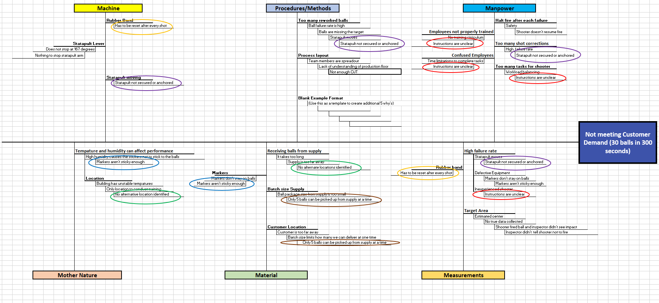
Analyze Phase – Fish Bone

Slide 18
Analyze Phase – Pareto Chart

Slide 19
Analyze Phase – Histogram
Distance
Mean | 38.85897436
Standard Error | 0.193473748
Median | 39
Mode | 39
Standard Deviation | 1.208243168
Sample Variance | 1.459851552
Kurtosis | 2.561504229
Skewness | 1.06864443
Range | 6
Minimum | 37
Maximum | 43
Sum | 1515.5
Count | 39

Slide 20
Improve Phase – [Tool/Topic]
Include significant tools used, such as:
  List of Improvements
  Future State Map
  SOP
  5S
  Pull System / Kanban
  Mistake Proofing
  Streamlined forms
  Analytical Batch Sizing
  Total Productive Maintenance
  Design of Experiments (DOE)
  Piloting
  Etc.

Slide 21
Improve Phase – Improvement Plan
Process and/or Equipment | Root Cause | Process Change | Projected Effect
Check-in Process | No supervision of Marines in the On-boarding process | Create a Checkin that enables the Supervision of Marines | Leadership will be able to supervise Marines in the On-boarding process
Check-in Process | There is no timeline on when Marines should have the Battalion Check-in completed | Create a checklist that tells Marines they will have 7 days to complete Battalion Check-in | Marines will have completed Battalion Check-in within 7 days
Check-in Process | There is no timeline for Marines to have RMB training completed by | Create a checkin process that tells Marines when training should be completed | Marine will have all training completed within 30 days of check-in
Training | Marines don't don't know what training requirements are needed | Create a check-in process that outlines what training the Marines need to complete | Marines will have all training completed in a specific amount of time
Training | Every Marine completes training a different way | Creat a training standard that enables Marines to know what training is required and timeline to complete. | Marines will complete all training systematically to allow them to completed within- 30 days
Training | No Training is being tracked | Create a sharepoint/teams site that tells the supervisor where the Marine is in the Training pipeline | This will enable the supervision of Marines through the check-in process
Communication | Marines are not speaking with leadership in their onboarding process | Create a sharepoint/teams site that allows Marines the ability to update leadership on the status of their check-in and onboarding process | This will enable leadership to know the current Onboarding status.
Communication | Marines are not speaking with leadership during their onboarding process | Provide checklist with timelines on when the Marine should communicate with leadership | This will provide leadership the ability to verify status
Manpower | Critical Billets are delayed being filled due to the Marine's check-in process taking too long | Create a Onboarding Checklist that enables Marines to complete requirements within 60 days | All Marines will have all On-Boarding requirements met within 60 days

Slide 22
Improve Phase - Tips
Standard Operating Procedure(s) are critical to success
Use visuals if audience is unfamiliar with process / work place.
Most improvements aided by pictures
  5S: before and after
  Pull System / Kanban: illustrate process
  Shop / Office Layout: before and after
  Mistake Proofing ideas
Provide templates / examples for other improvements
  Streamlined forms (printout if electronic)
  Kanban Cards
  Current and Future State Maps (comparison)

Slide 23
Improve Phase – Future State Map

Slide 24
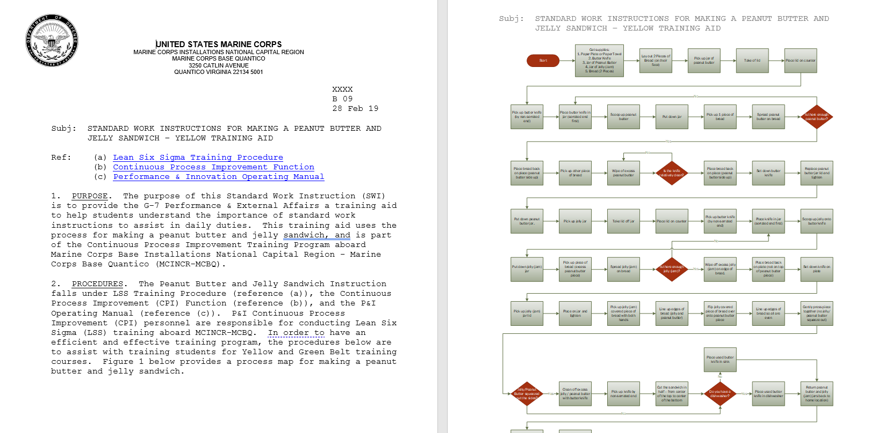
Improve Phase – SOP

Slide 25
Control Phase – [Tool/Topic]
Include significant tools used, such as:
  Control Plan
  Standard Work Instructions / Standard Operating Procedures
  Control Charts
  Statistical Process Controls
  Replication
  Feedback / Lessons Learned
  Etc.

Slide 26
Control Phase – Tips
Control Phase topics should include:
  How will improvements be maintained
    Who is responsible to maintain improvements
      Supervisor / Entire Office
    Creation, maintenance and retrieval of:
      Work instructions
      Control charts
      Metrics
  Feedback on CPI / DMAIC process
    Overall satisfaction with event / project

Slide 27
Control Phase – Control Plan
Control Plan
Process and/or equipment | Input or output | Measurement Technique | Specification and/or Tolerance | Sample Size and/or Frequency | Reaction Plan
What process or equipment being controlled? | Is it an Input or Output that needs to be controlled? | How are the inputs or outputs being measured? | What are the specifications or tolerance that is required to be in control? | How much or how often is the process or equipment being measured? | What does someone need to do to bring it back into control? Who is responsible?
Receiving Supply | Acceptance Rate | Measure Weight | 4oz. +/- 0.25oz. | Every 5th Ball | Reject lot if under 95% acceptance
Statapult Leather Band | Force of Statapult lever on base | Measure Force | 50lbs. +/- 5 lbs | Every Shot | Replace Leather Band
Product Inspection | First Pass Yield Rate | Pass/Fail, Count | 99% Pass Rate | Every shot | Halt production, investigate
Statapult Process | Lead Time | Time (Supply to Delivery) | 275 secs. +/- 25 secs. | Every order | Halt production, investigate
Workplace Safety | Mishap Rate | # of mishaps per month | 0 days | Monthly | Safety Stand-down

Slide 28
Additional Items – Project Benefits
Review benefits of event / project
  Return on Investment
  Before and after metrics
  Just-do-its
  Reductions in:
    Space used
    Time spent
    Resources allocated
    Funds spent
    Items repurposed
Identification of additional opportunities

Slide 29
QUESTIONS?

