Slide 1
JTR Changes - Feb 2025
MAP-CAP 05-25(S) – Implementing Executive Order, Unleashing American Energy.
In accordance with Executive Order of January 20, 2025, Unleashing American Energy, this revision removes travel policies mandated by Executive Order 14057 of December 8, 2021, Catalyzing Clean Energy Industries and Jobs Through Federal Sustainability, Federal Travel Regulation (FTR) Bulletin 24-02, and Office of Management and Budget (OMB) M-24-05.
Affects JTR pars. 0202, 020203, 020206, 020209, 020212, 020213, Table 2-10, and Table 2-11.
Notes:
Feb 2025 the JTR changed Constructed Travel requirements as described on this slide. We’ll go through this in the upcoming slides.

Slide 2

JTR Changes - Feb 2025
“Commercial airplane is the preferred mode for official travel more than 400 miles one way or more than 800 miles round trip.” - JTR 020206 par M. Also review Table 2-10 and 2-11
Notes:
The JTR changes in Feb 2025 went back to the 400/800 mile “rule” as shown on this slide. This means any travel over 400 miles one way or 800 miles round trip should be using Commercial air. So, for example, if a traveler wants to drive their POV instead of flying and their TDY destination is over 400 miles one way or 800 miles round trip, then the traveler must do a Constructed Travel Worksheet (CTW) to compare the costs of POV mileage vs. Air. JTR Table 2-10 explains this further while table 2-11 discusses POV vs. other modes of travel for comparison.

Slide 3

Constructed Travel
Prior to performing official travel, the Authorizing Official (AO) will authorize/direct the traveler to use a specific transportation mode (i.e., the directed transportation mode) - JTR 0202
When Government transportation is not directed, commercial travel by airplane, train, bus, or ship is generally the most advantageous method of transportation and should be selected when reasonably available. Of these types, travel by airplane is usually preferable when available. - JTR 020203
Travelers may choose to use a different transportation mode (i.e., the selected transportation mode) - JTR Table 2-11
The most common example: AO directs a traveler to use commercial air, but the traveler decides to drive their own car instead. Also known as: Privately Owned Vehicle (POV)
Notes:
Constructed Travel is not a favorite topic for anyone, but understanding how constructed travel works can protect you from financial loss.
You should talk to your AO well in advance of travel if you plan on using a different transportation mode than that normally directed to a TDY location. Normally, the directed mode will be commercial air but could be different depending on the location. You, the traveler will need to spend some time and effort preparing a CTW correctly.
What is the most common example for constructed travel? The AO directs commercial air, but you want to drive your car or “POV”, as described in the previous slide. We typically see this with the TECOM funding letter which sets the governments limit on reimbursement; TECOM directs the transportation mode along with government lodging & messing use unless CNA/SNA is obtained.

Slide 4
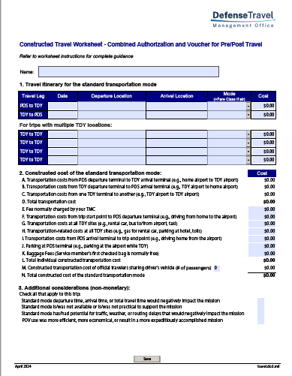
Constructed Travel
The JTR allows the traveler to use their selected transportation mode, but it also directs the AO to limit their transportation reimbursement if their choice is more expensive
This is known as Constructed Travel; lets the AO compare the true costs of the same trip using different transportation modes
Constructed Travel Worksheet (CTW) dated April 2024 should be utilized, all others are obsolete https://www.defensetravel.dod.mil/CnstTvl/
Do NOT use a saved version of the CTW
Notes:
Even though the traveler may select a different mode, The AO has the responsibility to determine what is advantageous to the government and potentially limit the traveler. This is known as Constructed Travel.
The Constructed Travel Worksheet (CTW) allows the Traveler and AO to see a comparison between the mode the traveler chose (selected mode) vs. the authorized/preferred mode. The CTW changes often so make sure to use the version from the advisory or the pre-audit link. The DTMO website has the most current version there.
The current CTW was updated 1 April 2024. All previous versions should not be utilized.

Slide 5
Constructed Travel Worksheet
When Constructed Travel applies, here’s what happens:
  The traveler creates their DTS authorization to show the total costs of the trip for their selected transportation mode.
  The traveler completes a Constructed Travel Worksheet (CTW) to show the estimated cost (a.k.a., the constructed cost) of the directed transportation mode and attaches it to the DTS document. The traveler may also include cost avoidances and additional considerations on the CTW.
  The AO considers the information in both the authorization and the CTW and decides how to authorize the trip:
    To allow full reimbursement for the selected transportation mode.
    OR
    To allow the traveler to use their selected transportation mode but limit the traveler’s transportation reimbursement to the constructed cost of the directed transportation mode.
Notes:
Here’s how the process works if the traveler is choosing to use a selected mode that is different than the directed/authorized mode.
The traveler creates their DTS authorization to show the total costs of the trip for their selected transportation mode such as POV mileage To/From TDY.
The traveler then completes a Constructed Travel Worksheet (CTW) to show the estimated cost of the directed transportation mode and attaches it to the DTS document. The traveler can include cost avoidances and additional considerations on the CTW.
The AO then considers the information within the authorization and CTW before deciding how to authorize the trip. The AO has two options:
To allow full reimbursement for the travelers requested/selected transportation mode.
To allow the traveler to use their requested/selected transportation mode but limit the transportation reimbursement to the constructed cost of the directed transportation mode.
Remember, the AO’s job is to get the mission accomplished as efficiently as possible along with having the government’s best interests at the center of this decision. The traveler’s personal convenience or desires cannot factor into the AO decision.

Slide 6

Constructed Travel Worksheet
  Scenario:
  EXAMPLE ONLY - may not reflect current $ values for air, rental, etc.
  Traveler is directed to Tampa, FL (33608) for 7-day TAD period (1 travel day down, 5 duty days, 1 day travel return)
  Traveler resides in Stafford, VA (22556)
  Traveler is directed to use standard (preferred) mode (Air) but requests to drive a POV
  No additional travelers are making the trip
Notes:
Let’s walk through a scenario together that illustrates the process. Every CTW situation is different and must be handled on it’s own merit, this is just an example.
A traveler is directed to MarCent, Tampa, FL for a 5-day TAD period, that’s 5 TAD days and a travel day each way totaling 7 days.
The traveler lives in Stafford, specifically in the 22556 zip code. The zip code is important because that’s how you claim mileage to/from TDY.
The AO directed the traveler to use the standard mode which is air (this is normal and the whole point of this process)
No other travelers are making the trip. This is an important note that will be used in section 2.

Slide 7
Constructed Travel Worksheet
  How do you determine the contract airport?
  MCBO 7220.1D para 4.g directs IAD & DCA as the servicing terminal for MCBQ
  Richmond (RIC) may be considered when equal to or less than Dulles (IAD) and Reagan National (DCA)
  GSA City Pair search contains all contract routes, the cheapest route is considered the servicing terminal City Pair Program (CPP) | GSA
  Traveler will need to gather additional information
Notes:
Contract airport is defined as the terminal that has the lowest cost YCA fare for the route being used. Next slide will demonstrate this more clearly.
When a traveler is requesting to use something other than the standard mode the responsibility is on the traveler to collect and present the information to allow the AO to make an informed decision. The JTR does not allow the AO to make this decision without a clear understanding, JTR 010104. The CTW is designed to assist the traveler and the AO to adhere to JTR 010102 & 010103, to travel responsibly.

Slide 8

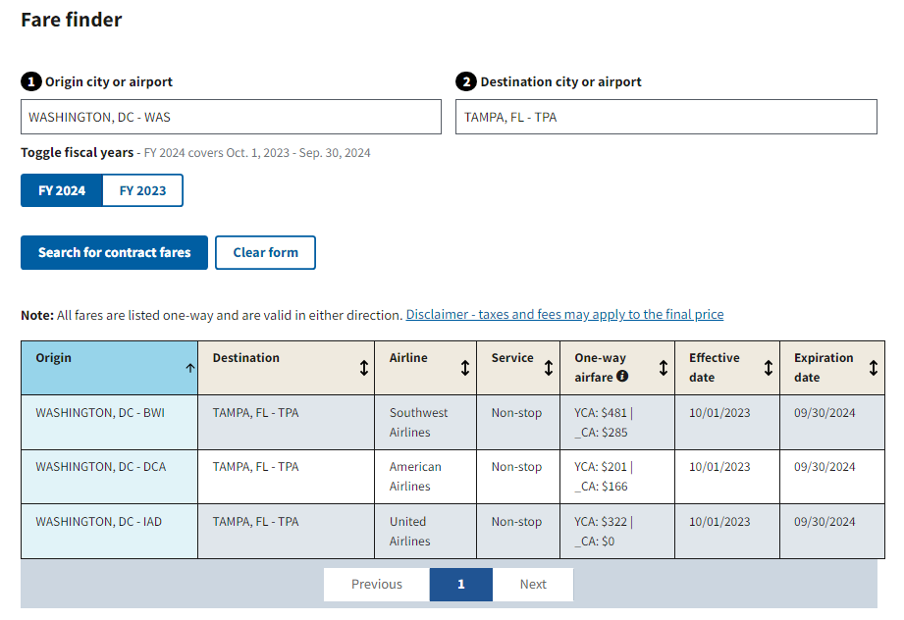

Constructed Travel Worksheet
https://www.gsa.gov/travel/plan-a-trip/transportation-airfare-rates-pov-rates-etc/airfare-rates-city-pair-program
Notes:
Using your favorite search engine type in the words “GSA City Pair”, the first option should give you the link indicated above by the right facing arrow.
If you are unsure of the which airport is the contract airport you may use WAS in place of BWI, DCA and IAD. RIC is not included in this search. Placing WAS in the origin and Tampa (TPA) in the destination returns the result currently displayed. This query determines that DCA is considered the contract airport as it has the cheapest YCA cost.

Slide 9
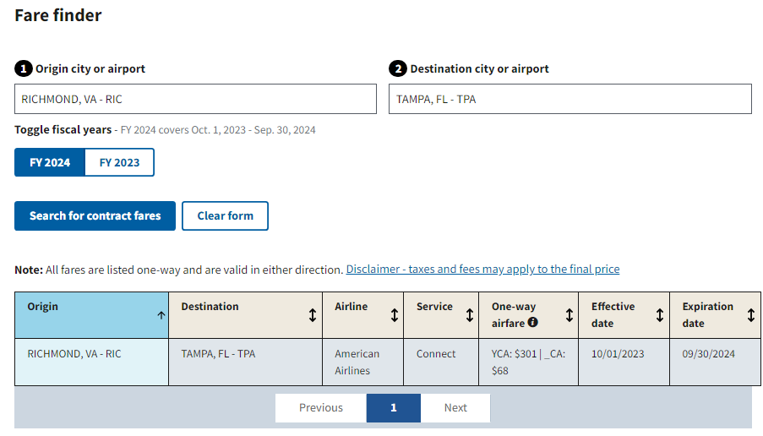
Constructed Travel Worksheet
Notes:
The previous screen reflected DCA at $201 and here Richmond is coming in at $301 and a limited capacity airfare of $68. However, if the traveler is not flying this information is not relevant to the preparation of this CTW.
Important note: If the traveler lives closer to RIC than DCA only DCA can be considered on the CTW per the Marine Corps Base Quantico Local Travel Order (MCBO 7220.1D)

Slide 10

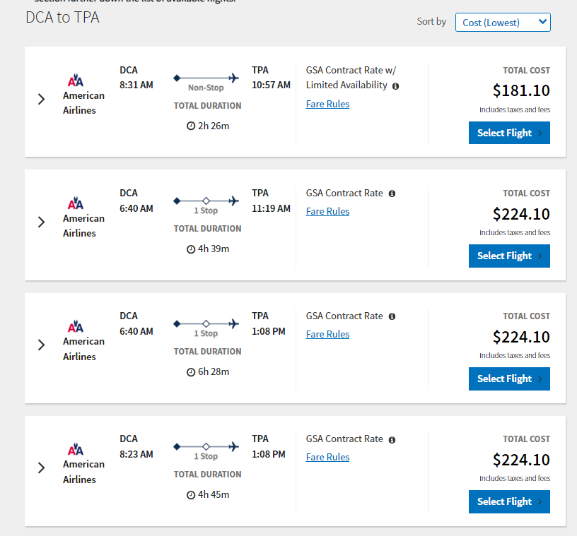
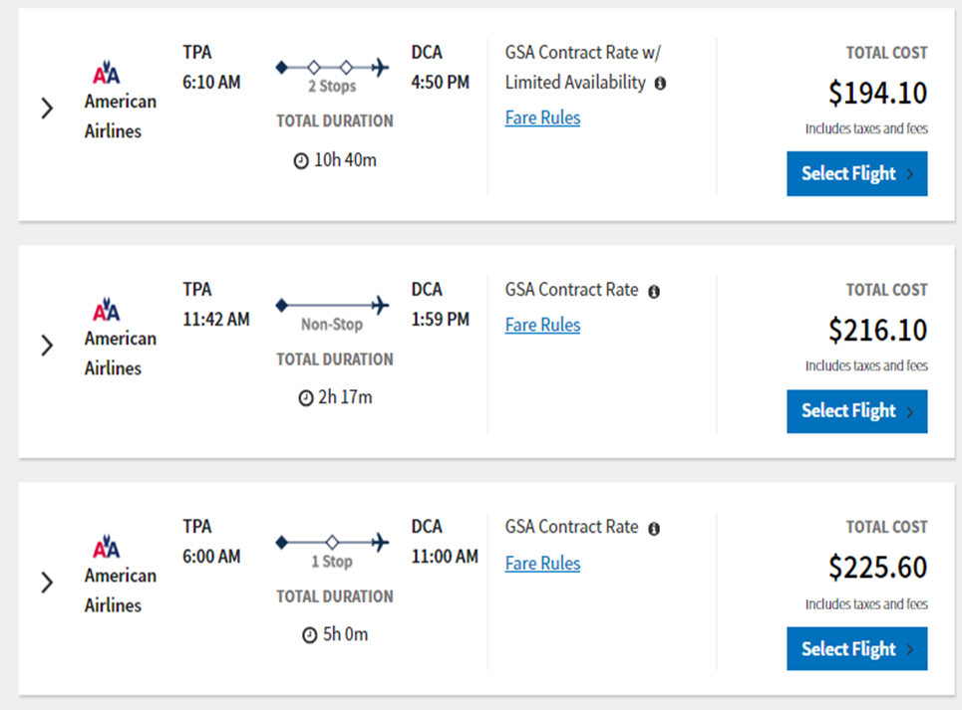
Constructed Travel Worksheet
Section 1
Search Result using DCA
Notes:
For our purposes today we will not pursue RIC and move back to the contract airport of DCA. Here are screenshots of airfares found in DTS.

Slide 11

Constructed Travel Worksheet
Section 1
Search Result using DCA
Notes:
You can see on the screen, the lowest cost fare is $181.10 for DCA and $194.10 for TPA but we need to move past that because it shows w/ Limited Availability, known as a Dash CA (-CA) fare, which are not allowed to be used in constructed travel. This would be a disadvantage to the traveler for comparison purposes.

Slide 12

Constructed Travel Worksheet
Section 1
Search Result using DCA
Notes:
Instead, you want to use the YCA or contract airfare which reflects $224.10 down and $216.10 back. The amount of stops or layovers are not considered for comparison purposes. In our scenario roundtrip will come to $440.20. The CTO fee will always be the lowest cost of ($6.75) not the higher cost touch fee. Yes, inserting the higher cost touch fee is incorrect.
Keep the airfare and other screen shots and add to your CTW when uploading into DTS

Slide 13
Constructed Travel Worksheet
Section 1
Traveler must select the standard transportation mode (Air), not the mode being requested/used. And when selecting Air, the fare class (YCA) must also be added.
YCA
In this scenario the standard mode is air as the TAD/TDY location is more than 400 miles from the PDS.
YCA
Notes:
Once the traveler downloads and then opens the CTW they need to start filling it out. We’ll go section by section and break down where all the information comes from. It has been determined that DCA is the contract terminal, and the airfare cost (including taxes & fees) were obtained and now recorded in Section 1 of the CTW. The CTW will always be prepared to what the government would have incurred not what the traveler prefers.
In section 1 under “Mode” they will select the standard/directed mode of transportation which in this case is Air per JTR 0202. Each TAD/TDY will need to be considered on its own facts of the situation..
Each leg of travel will be its own line. Layovers are not a leg, it means PDS to 1st TAD location etc.
Next, we will be moving on to Section 2.

Slide 14
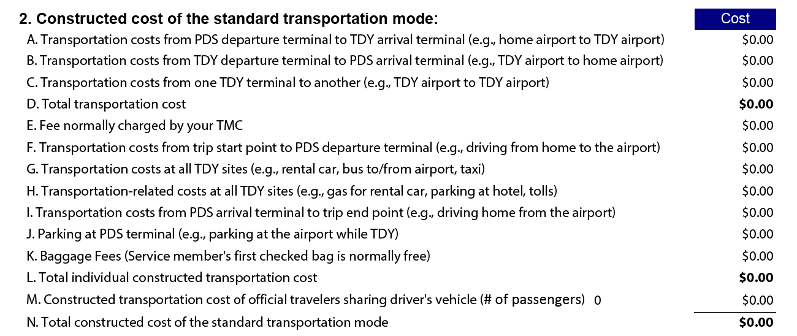

Constructed Travel Worksheet
Section 1
Notes:
This is a significant change from previous CTW. Any area not in bold font is considered in this process. Let’s discuss them to eliminate confusion in this matter.
2A&B will auto feed from the information inputted in section 1.
2C would capture the cost if you were required to obtain transportation from one terminal to another. In our Tampa scenario, this will not be utilized.
2E represents the lowest cost of $6.75.
2F&I represent the mileage cost from home/PDS to the servicing terminal and return. For CTW you do not double the mileage there and back and must treat it as you would be parking at the terminal.
2G would represent rental vehicle cost, public transportation cost from the TAD/TDY terminal to your lodging/area where the duty would be performed.
2H would factor in additional cost such as fuel, parking at the lodging facility and tolls.
2J would account for parking at the departure terminal, use the economy lot price.
2K any bag fees incurred.
2M would contain a calculation if more than one traveler who will be riding with the traveler.
Note: The AO cannot direct anyone to use their POV or anyone else to ride in that POV. A traveler can voluntarily offer to let another traveler ride, never directed. Any injuries that occur would not be the responsibility of the government.

Slide 15
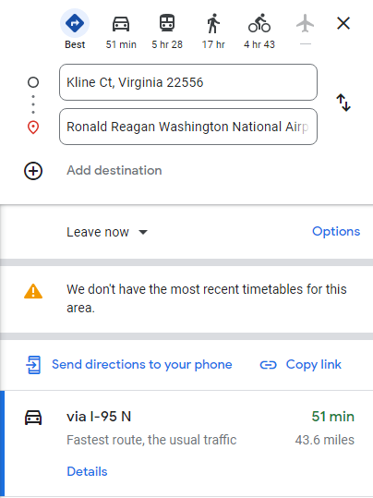
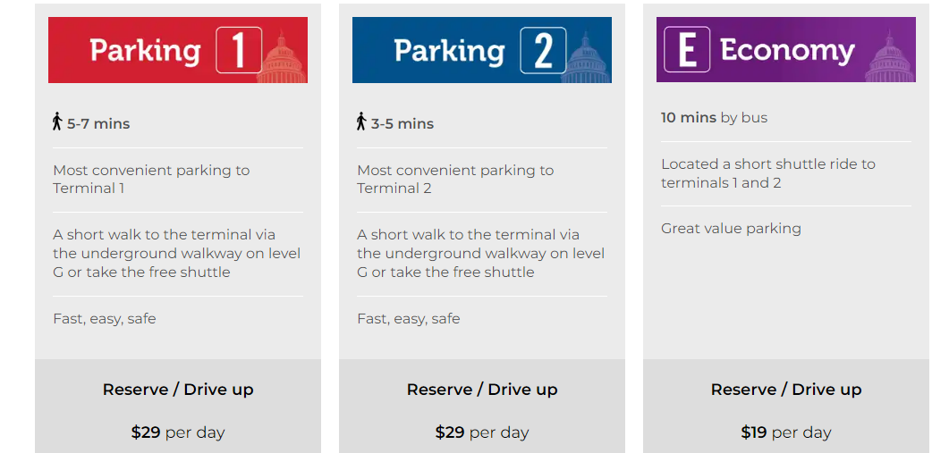

Constructed Travel Worksheet
Section 1
Notes:
To fill in the information you may use a variety of sources; screen shots of the YCA airfare from DTS, google maps or other mapping services to determine the distance from your departure point the servicing terminal, website containing the parking information at the servicing terminal, screenshots of the rental information found in DTS and other websites containing the information needed to complete section 2.
Past trends show people tend to take the easy way and do not gather this information. Not collecting this information prior to trip may result in a lower reimbursement.
For our scenario, the mileage each way to the servicing terminal is 44 miles and parking cost is $19 per day.
Keep the cost comparison screen shots and add to your CTW when uploading into DTS.

Slide 16
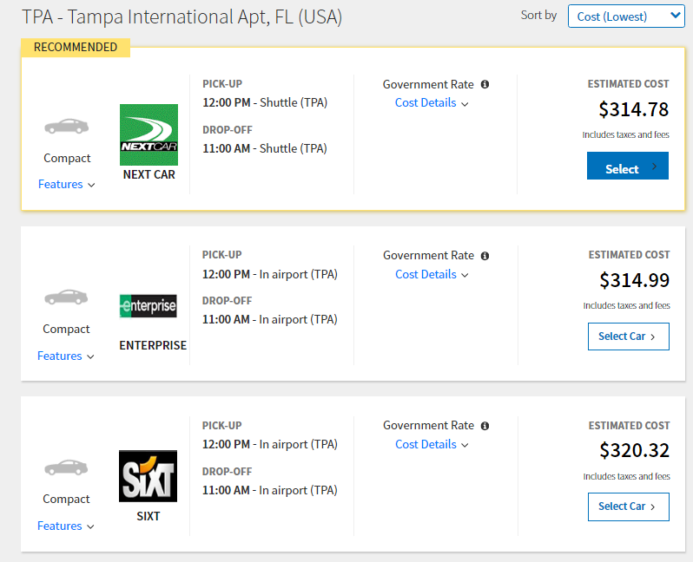
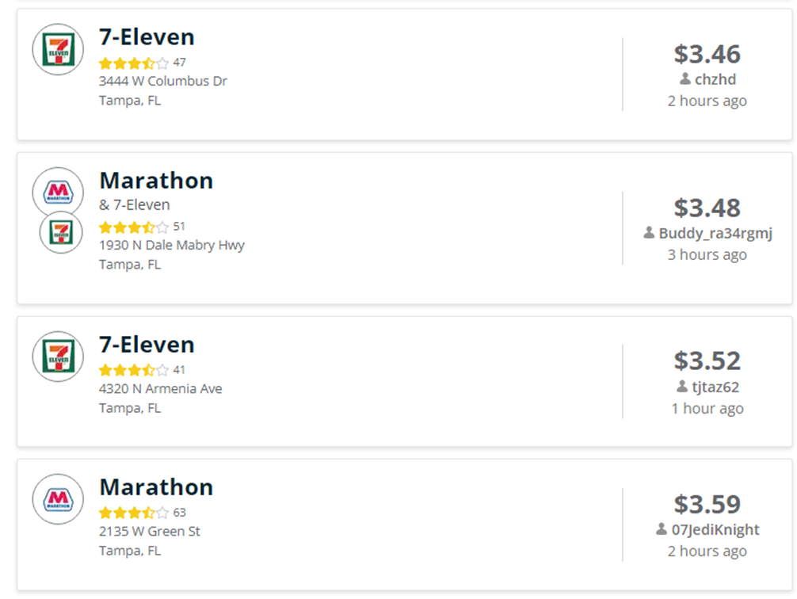

Constructed Travel Worksheet
Section 1
Search Result using TPA
Notes:
Obtaining a rental vehicle would cost $314.78 for the week. The lodging facility is 20 miles from the airport and 5 miles from where the TAD/TDY will be performed estimated minimum of 90 miles not including chow runs. Estimate 4 gallons at 3.51 (average from the screenshot above) for an estimate of $14.04.

Slide 17

Constructed Travel Worksheet
Section 2
Notes:
Upon obtaining the information we can start filling in section 2.
With section 2 completed it is now possible to see the total airfare cost in 2D, total avoided cost is displayed in 2L. 2M in this scenario is not utilized. 2N adds 2D & 2L and provides a reasonable cost of what the government would have incurred.
The amount in 2N is what will be compared to the cost of the traveler's preferred mode of transportation.

Slide 18
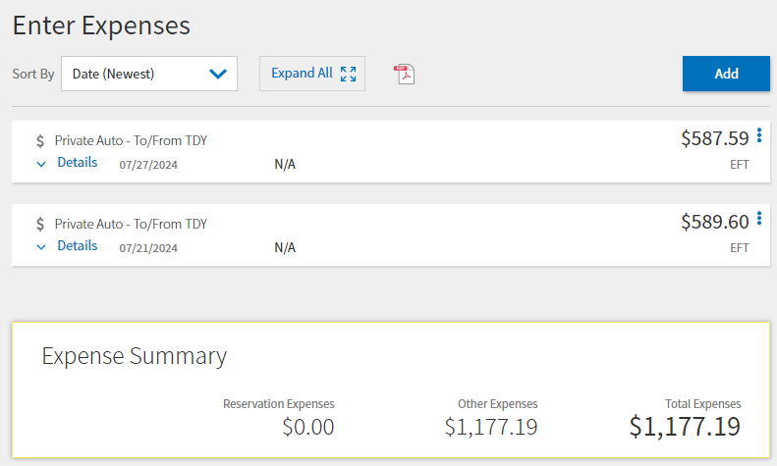
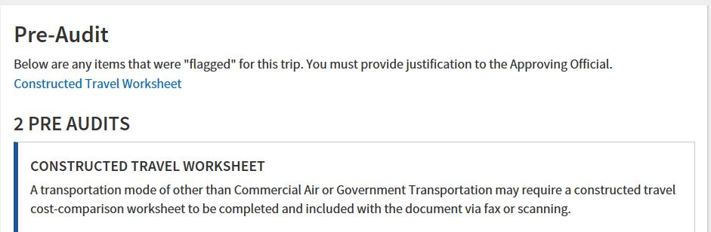
Constructed Travel Worksheet
  The Constructed Travel Worksheet (CTW) should be available when adding a mileage expense or in the Pre-Audit screen anytime a mode other than Air is shown on the authorization.
Notes:
Obtaining the cost to use the traveler’s preferred mode of transportation is to simply enter the information in the Expense tab of the authorization, must use zip code to zip code calculations, to obtain the associated round trip cost. The preferred mode in our scenario is driving and reflects a roundtrip cost of $1,177.19.

Slide 19
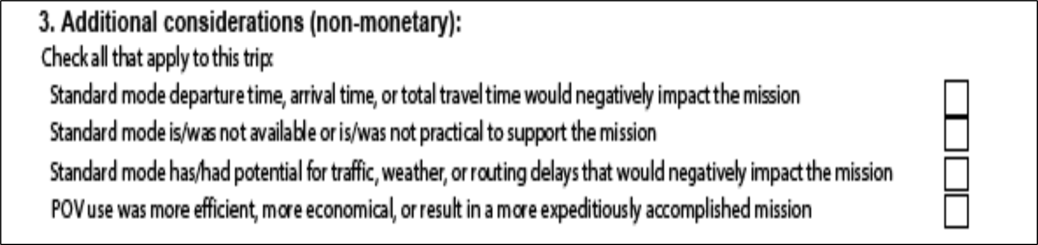
Constructed Travel Worksheet
Section 3
Section 3 is used to assist the AO in determining if requested mode is advantageous to the government
Highlights other non-monetary circumstances that may drive the AO’s decision
Cannot be a factor when Leave In Conjunction With Orders (LICWO) is involved
Notes:
Section 3 is available to address any non-monetary considerations. Any item checked here must be justified within DTS and may require additional documentation. (May read through some of the examples in section 3)
The Approving Official will need to consider all cost and non-cost factors and then decide whether to authorize the traveler’s transportation mode, or to limit to the constructed cost.

Slide 20
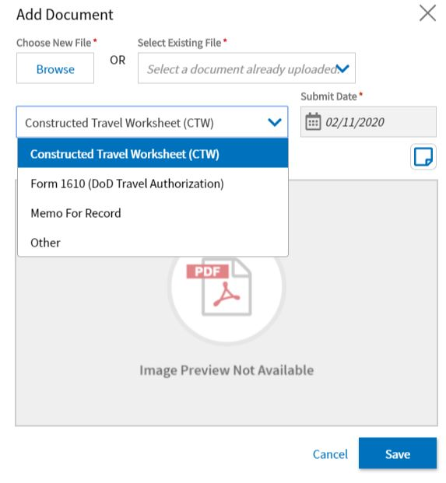
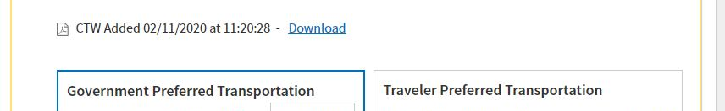
Constructed Travel Worksheet
The CTW must be loaded as that document type
Allows quick access for the AO in the Sign and Submit screen
Notes:
Once the traveler has completed the CTW, they will load it to their DTS authorization, making sure to load it as the correct document type. If they don’t load it correctly, The AO won’t be presented with the options they need in order to authorize it correctly. The right is what they will see in the Sign and Submit screen if it’s loaded correctly and can save the document from there instead of having to navigate to the Expenses screen to see it.
The upload will need to consist of the CTW and any supporting records reflecting the cost.

Slide 21

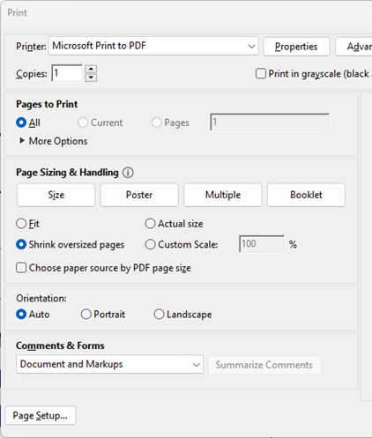
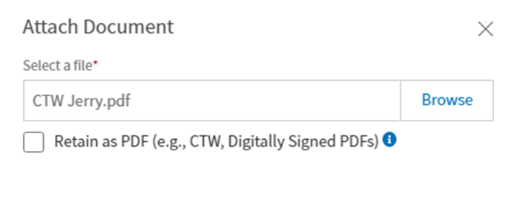
Constructed Travel Worksheet
Use Print to PDF
Do NOT select
Notes:
When preparing the CTW for upload it has been common for folks to see the “Please Wait” notification. If this is present on your voucher the CTW did not load correctly. To ensure this does not present problems on the voucher approval it is recommended that you print the CTW via the Microsoft Print to PDF option. This will disable the “Please wait…” problem.
Finally, it is recommended to load as a PNG, by not selecting retain as a pdf. By not selecting retain as a pdf the document will be converted and you will know immediately if the document is readable. Otherwise, it will be necessary to view the pdf that was loaded to ensure it is viable.

Slide 22
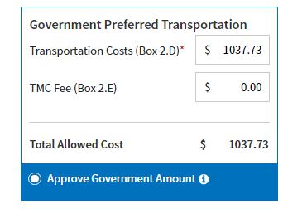
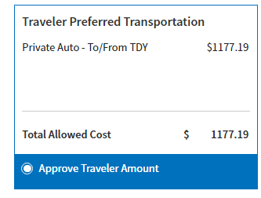
Constructed Travel Worksheet
Note: For vouchers, the choice is only presented to the Finance Office
Notes:
The unit AO will only see the CTW limitation screen on the sign & submit page of the authorization, Disbursing AO’s will see it on the vouchers.

Slide 23
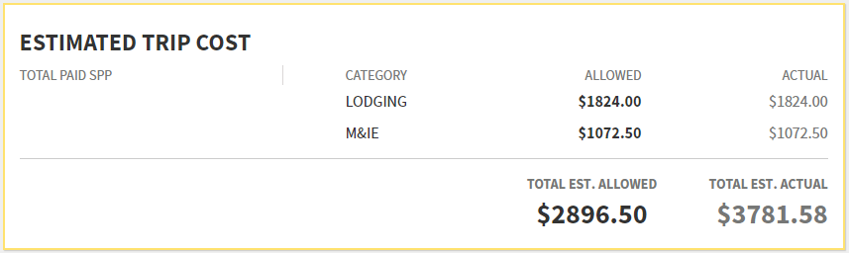
Constructed Travel Worksheet
When a document is Approved as Limited, the Actual and Allowed columns will be different
Notes:
This is what the accounting screen would look like if was limited by the AO. These numbers don’t match the scenario, its just to illustrate that the actual amount is more than the allowed amount.

Slide 24
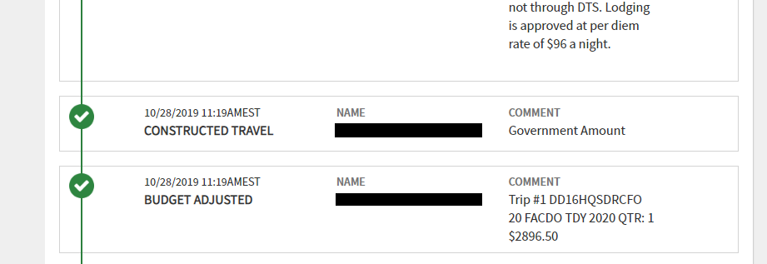
Constructed Travel Worksheet
When a document is Approved as Limited, the CONSTRUCTED TRAVEL stamp will appear in the history on the sign and submit page
Notes:
The digital signature screen looks like this if the AO limited your traveler to the constructed cost.

Slide 25

Question?
What is the traveler’s transportation reimbursement if the traveler did not use the authorized mode?
Traveler may always claim the full reimbursement
AO may limit to the cost of the authorized transportation mode
Traveler did not use the authorized mode, no reimbursement
Organization’s local policy determines limitation
Notes:
Correct answer is “B”, AO is required to comply with what is advantageous to the Government, JTR 010104.

